Slide 1
Introduction to Scientific Research on Chan Ding 禪定 ⎯
Probing the new brain manifested in Diamond Sutra
禪定科學研究導論
Pei-Chen Lo 羅佩禎
生醫訊號研究實驗室
國立交通大學 電機工程學系、電控所 教授

Slide 2

The mainstreaming of mindfulness meditation
April 5, 2014 The Week
Stressed-out Americans, from war veterans to Google workers, are doing mindfulness meditation --- Pentagon leaders, General Mills, Silicon Valley entrepreneurs
Evan Williams, co-founder of Twitter says, "Meditation is a way to think more clearly and to not feel so swept up."
…Others are concerned that Fortune 500 executives are pushing meditation so that overworked employees can be even more productive without melting down. But Westerners clearly need some sort of strategy to cope with a world now filled with the inescapable distractions of technology. The average American now consumes 63 gigabytes of content, or more than 150,000 words, over 13.6 hours of media use every single day — and all indications are that those numbers will keep climbing

Slide 3
「無所住而生其心」的科學觀 ⎯ 從原子到宇宙、從腦科學到陰陽五行
腦科學看「住色聲香味觸法」的人腦 ⎯ I/O關係理論、Chaos 現象理論
腦科學看「禪定般若」⎯質能轉換
從科學看「五蘊皆空」到「般若」 ⎯系統upgrade的機制、軟體與硬體的最佳化
Futurology
Beyond the Mainstream
禪中無他心、定中無他相；從系統理論與腦科學看「當下」
「外離相為禪、內不亂為定」⎯系統的暫態(大腦)與穩態(本心)
人腦通達心靈智慧的門戶⎯發現神經網路的新功能區
「著境即煩惱，離境即菩提」的腦科學⎯CNS的SNR特性
「著境即煩惱，離境即菩提」的腦科學⎯從共振現象來解說

Slide 4



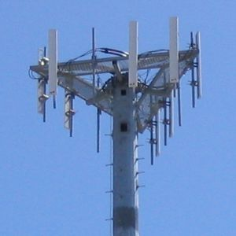
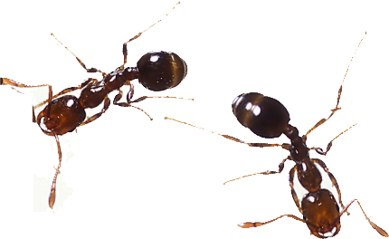

Futurology

Slide 5



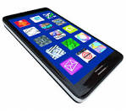
Do we correctly utilize our brain and mind?
How to revitalize and upgrade our body, mind, and spirit?
No Operational Manual !!
Man-made
？-made

Slide 6
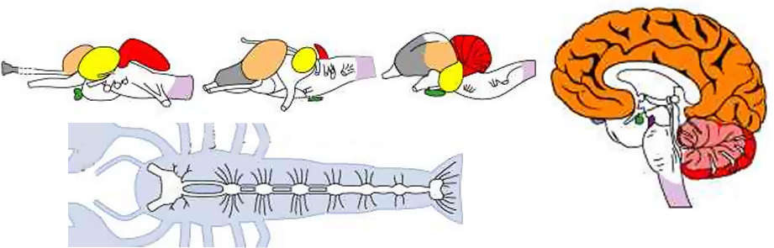
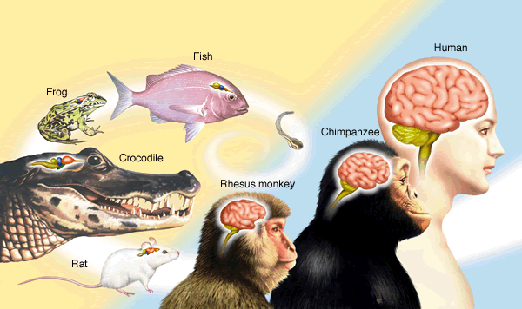
Brain evolution !
Fish
Optic lobe
Frog
Cerebrum
Bird
Olfactory bulb
Cerebral hemisphere
pituitary
cerebellum
medulla
●cerebellum
●optic lobe
●cerebrum
●cerebral hemisphere
●pituitary
●olfactory bulb
●medulla
↑www.solarnavigator.net/human_brain.htm
Brain plasticity
Brain.riken.jp

Slide 7
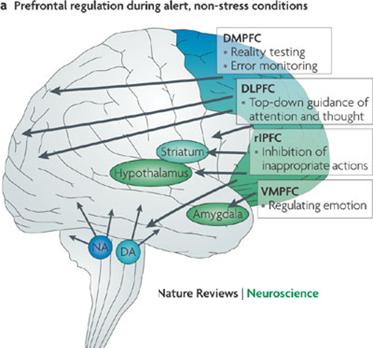
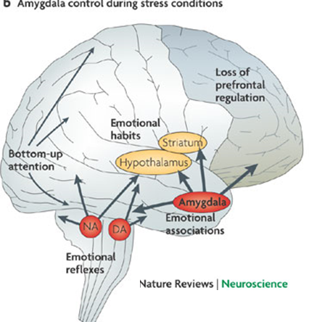
However ~ our brain often malfunctions !!
Top-down control by PFC Alert, non-stress pFC
Bottom-up control by sensory cortices during stress conditions
Right view
Notes:
DMPFC: Dorsomedial prefrontal cortex DLPFC: Dorsolateral PFC rlPFC:
VMPFC: Ventromedial PFC

Slide 8
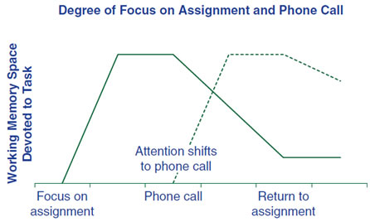
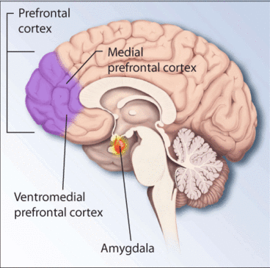
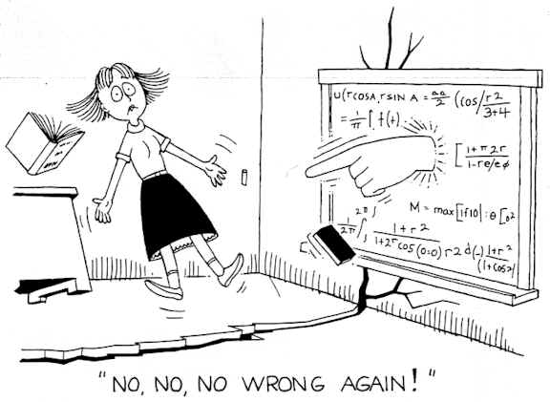
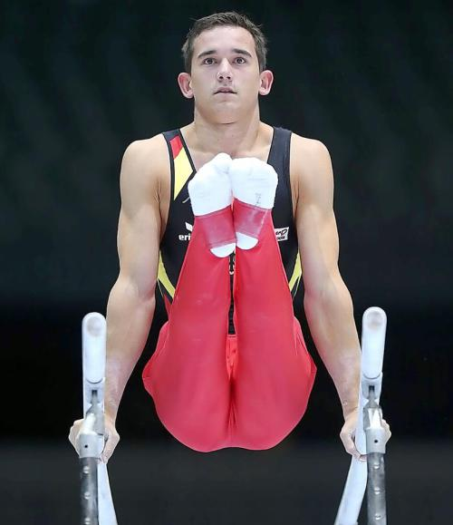
大腦劣根性！
frontal lobes (vmPFC): fear of failure → limbic system triggers fear responses, causing performance anxiety
Amygdala (react in 20 ms) triggers your emotions faster than your conscious awareness (300 ms)!
Transient vs steady state
Math anxiety
Performance anxiety
Negative cycling
Positive: 12 sec
Negative: 0 sec

Slide 9
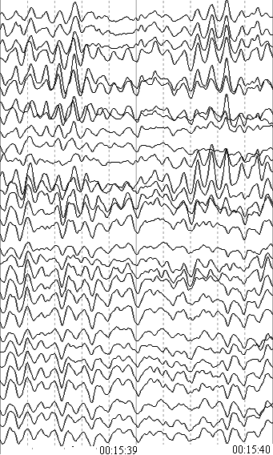
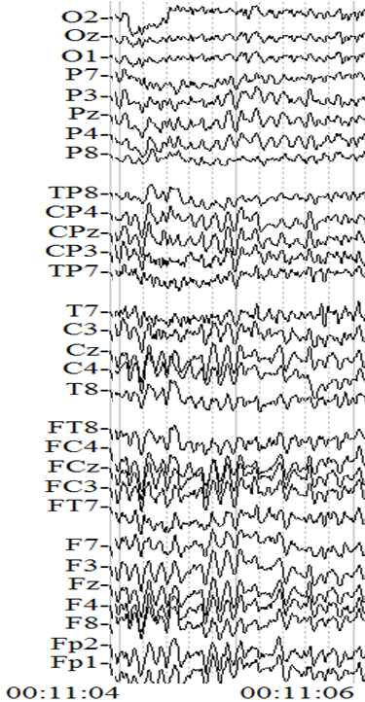
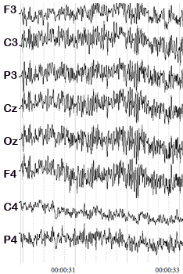
粗息 散亂心 → 專注 → 微息 精神力
超高頻 (>40Hz)gamma波
枕葉高頻α波
額葉低頻α波
Peak performance: Being in the zone ↑

Slide 10
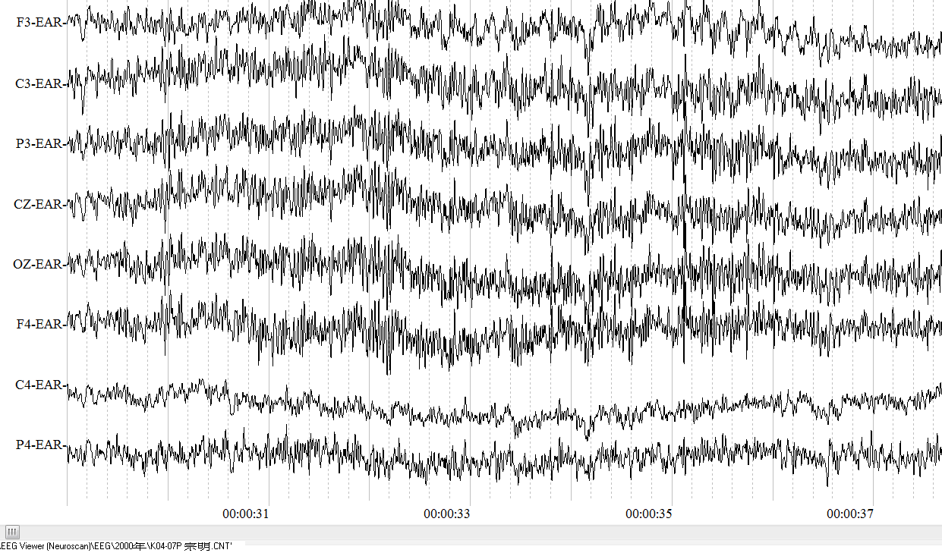
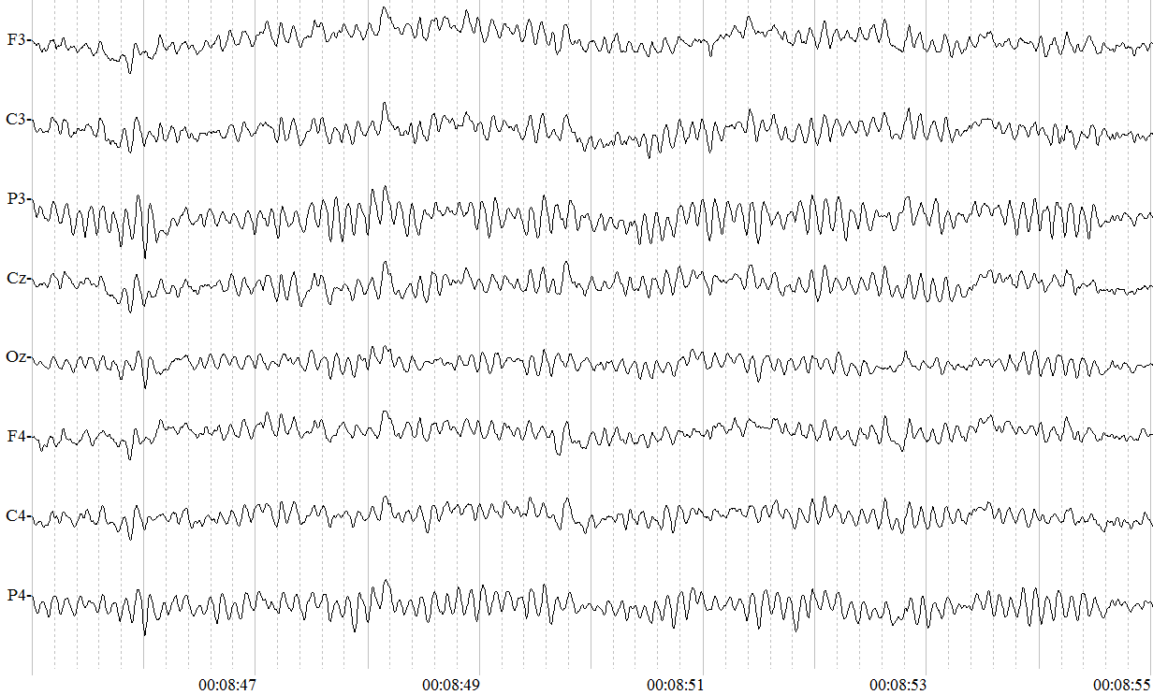
People with very high levels of gamma activity are exceptionally intelligent, compassionate, happy, and have excellent memories and strong self-control
High gamma activity corresponds to a state of peak performance
High levels of Gamma
exceptionally intelligent → being in the Zone (you can do anything)
Increased focus and processing speed , mindful → a brain state of peak performance
compassionate, happy, calm and peace (best anti-depressant), feeling of blessings
exceptionally vivid and rapid memory recall
Increased sensory perception …
Normal EEG ↑

Slide 11
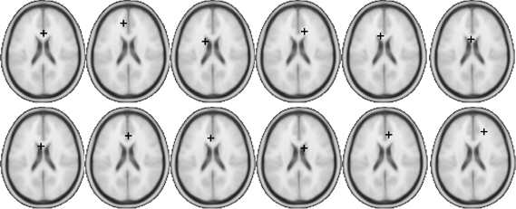
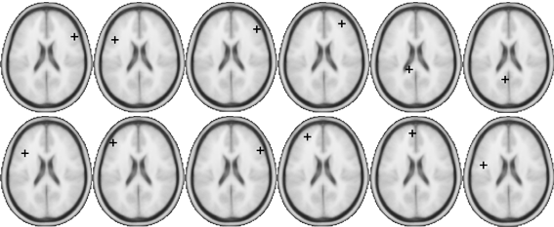
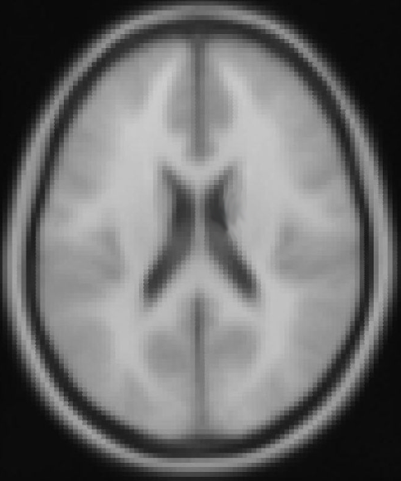
定 versus 散亂
禪定組
非禪定組
30-ch EEG recording montage

Slide 12
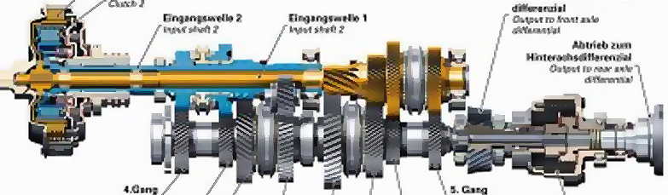
Cardiorespiratory synchronization
Average γ for the entire meditation
Average γ for DcRR ≥ 2 min
Average γ for DcRR ≥ 3 mi
Notes:
DcRR: duration of consistent RR

Slide 13
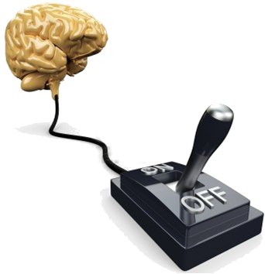

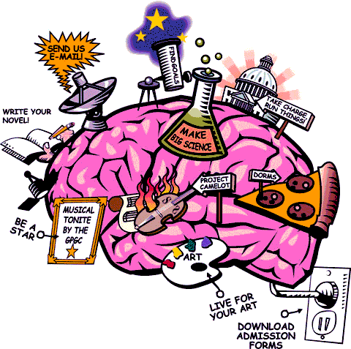
禪定
Turn off your Brain and Turn on your Heart
Operational manual
True Expert → 本心之內 方寸之間
Normal consciousness
Subliminal consciousness
CHAN
Alaya consciousness
Nirvana Samadhi
Unification heart & brain
5 senses

Slide 14
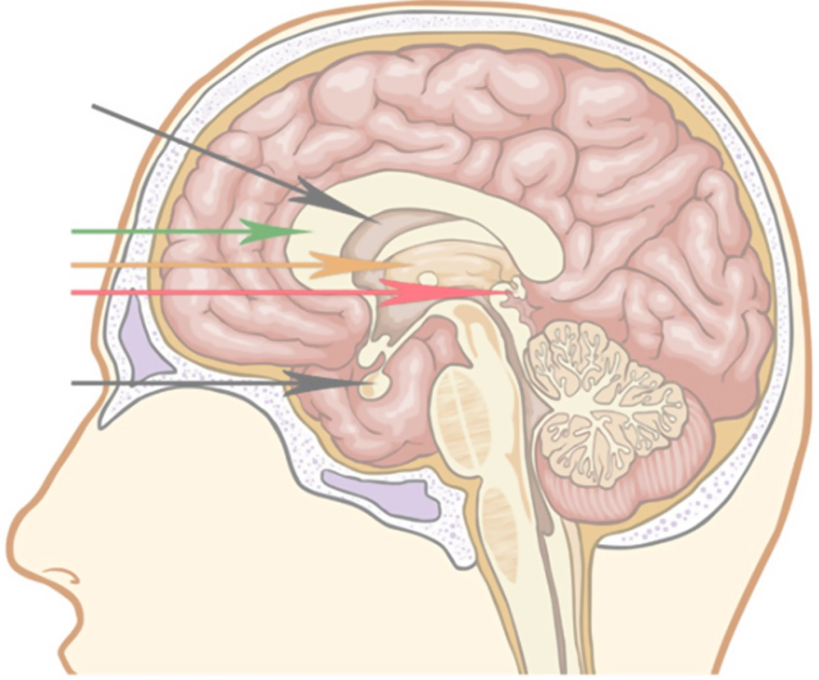
In preparation for Chan Ding
ChanXin-FaYan-ZhiHui→
Harmonize all brain neurons
Adjust doorway of thalamus
Cleanse emotional, mental, spiritual realm
Transcend time, space, physical state
ChanXin
Third Ventricle
Corpus callosum
Thalamus
Pineal gland
Pituitary gland
At Princeton University, a team of researchers has found a way to crystallize light— or transform light waves into crystalline solids.

Slide 15
Thank You

