Slide 1
跨領域學習生物資訊的
趨勢與挑戰
Chun-Chi Liu (Jim) ( 劉俊吉 )
Institute of Genomics and Bioinformatics
National Chung Hsing University
E-mail: jimliu@nchu.edu.tw
http://biochip.nchu.edu.tw/lab/
1
1
Notes:
Title: Systems Biology and Gene Function Study
Abstract: Systems biology usually integrates various biological systems such as genomics, transcriptomics, proteomics, gene regulatory networks, and pathways. Bioinformatics provides the integrating tools to perform the systematic data analysis and construct biological models. In this talk, I will introduce several computational systems biology methods, which can be used in gene function study.

Slide 2
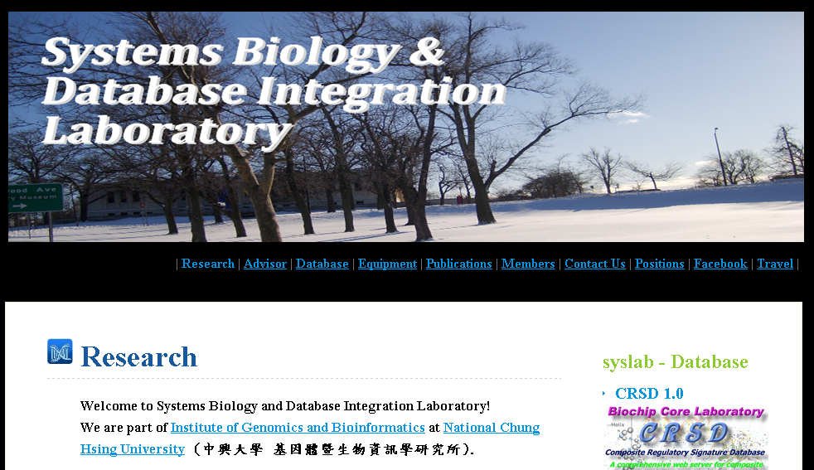
Systems Biology and Database Integration Laboratory
系統生物學與資料庫整合實驗室
http://biochip.nchu.edu.tw/lab/
Advisor
PhD Students
楊家俊
Master Students
曾毓婷
袁偉勝
劉俊吉
Chun-Chi Liu
陳怡穎
洪偉欣
專任研究助理
楊善淳
2011/6/3
2
2

Slide 3
Human Genome Project
The Human Genome Project (HGP) refers to the international 13-year effort (1990 ~ 2003) to determine the complete sequence of the 3 billion DNA subunits (bases in the human genome).
The Human Genome Project took 10 years and cost $3 billion USD (US Dollars).
The Celera genome sequencing project took two years and cost just $300 million USD.
http://www.wisegeek.com/what-is-the-cost-of-human-genome-sequencing.htm

Slide 4
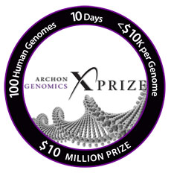
Archon Genomics X PRIZE http://genomics.xprize.org/
http://www.youtube.com/watch?v=_WBVRnvjfPE&feature=player_embedded

Slide 5
Human genome sequencing
A price has been offered for the first to sequence 100 human genomes for $10,000 USD each in ten days or less.
In 2001, the genome sequencing of James Watson was completed at a cost of $2 million USD.
In 2008, the first full genome sequencing services were sold commercially to customers for a cost of $100,000 USD.
By March 2008, one company, Applied Biosystems, completed a human genome sequencing in two weeks for $60,000 USD.
http://www.wisegeek.com/topics/genome-sequencing-service.htm

Slide 6
Next Generation Sequencing
本校因應前瞻性生物科技發展，於 2009年 花費 NT$20,000,000 購置了Solexa定序儀 (Genome Analyzer IIx)。
目前有多位教師使用Solexa定序儀進行了多項前瞻性的研究，內容涵蓋了 De novo genome sequencing, genome re-sequencing, de novo transcriptome sequencing, transcriptome re-sequencing。
Notes:
http://www.giichinese.com.tw/report/tak192391-next-generation-sequencing-opportunities-trends.html
http://www.giichinese.com.tw/report/tak192391-next-generation-sequencing-opportunities-trends_toc.html

Slide 7
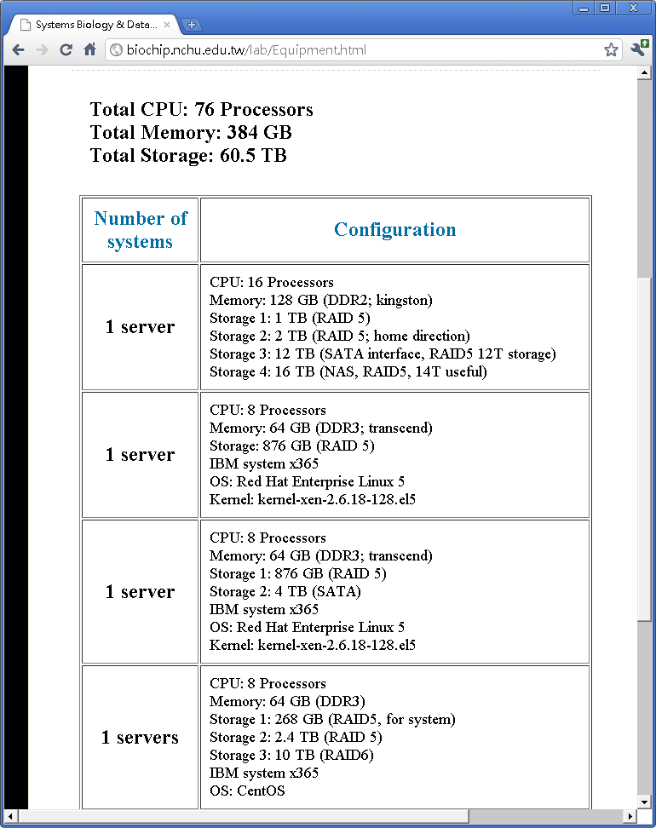
http://biochip.nchu.edu.tw/lab/Equipment.html

Slide 8
跨領域研究的重要性
當一個領域的研究接近飽和
就業上的競爭優勢
中興大學連續聘任 7 位生物資訊的教師

Slide 9
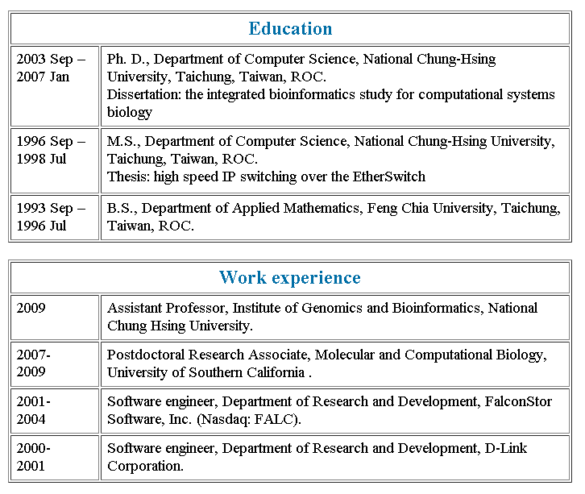
我的生涯歷程 http://biochip.nchu.edu.tw/lab/Advisor.html

Slide 10
過去的相關的研究工作
2011/6/3
10
Used ANN to design probes
Used network topology to classify cancer
Built the Composite Regulatory Signature Database (CRSD) http://biochip.nchu.edu.tw/crsd1
Developed the semi-supervised learning method with SVM and Manifold (Graph laplacian transformation)
Used Bayesian approach to build Disease Diagnosis Database

Slide 11
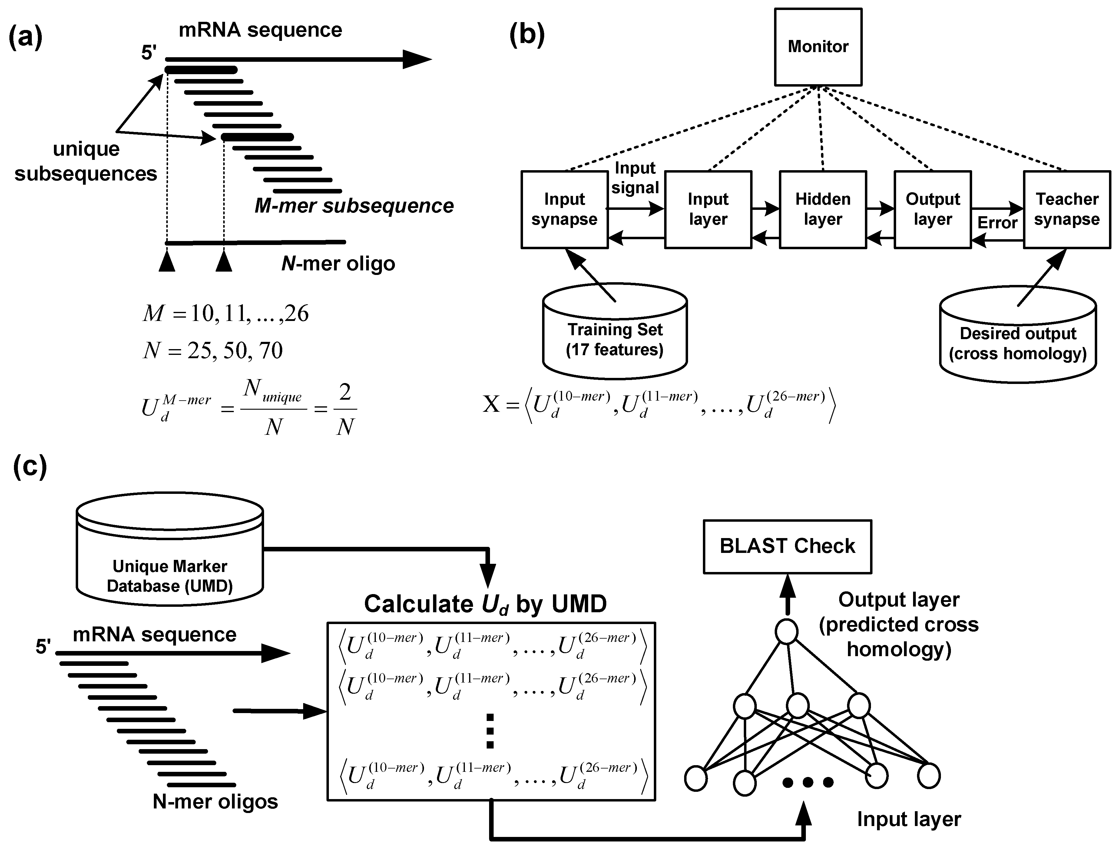
Used ANN to design probes
Chun-Chi Liu, et al. (2007) Genome-wide identification of the specific oligonucleotides using artificial neural network and computational genomic analysis.
BMC Bioinformatics 8:164.
2011/6/3
11

Slide 12
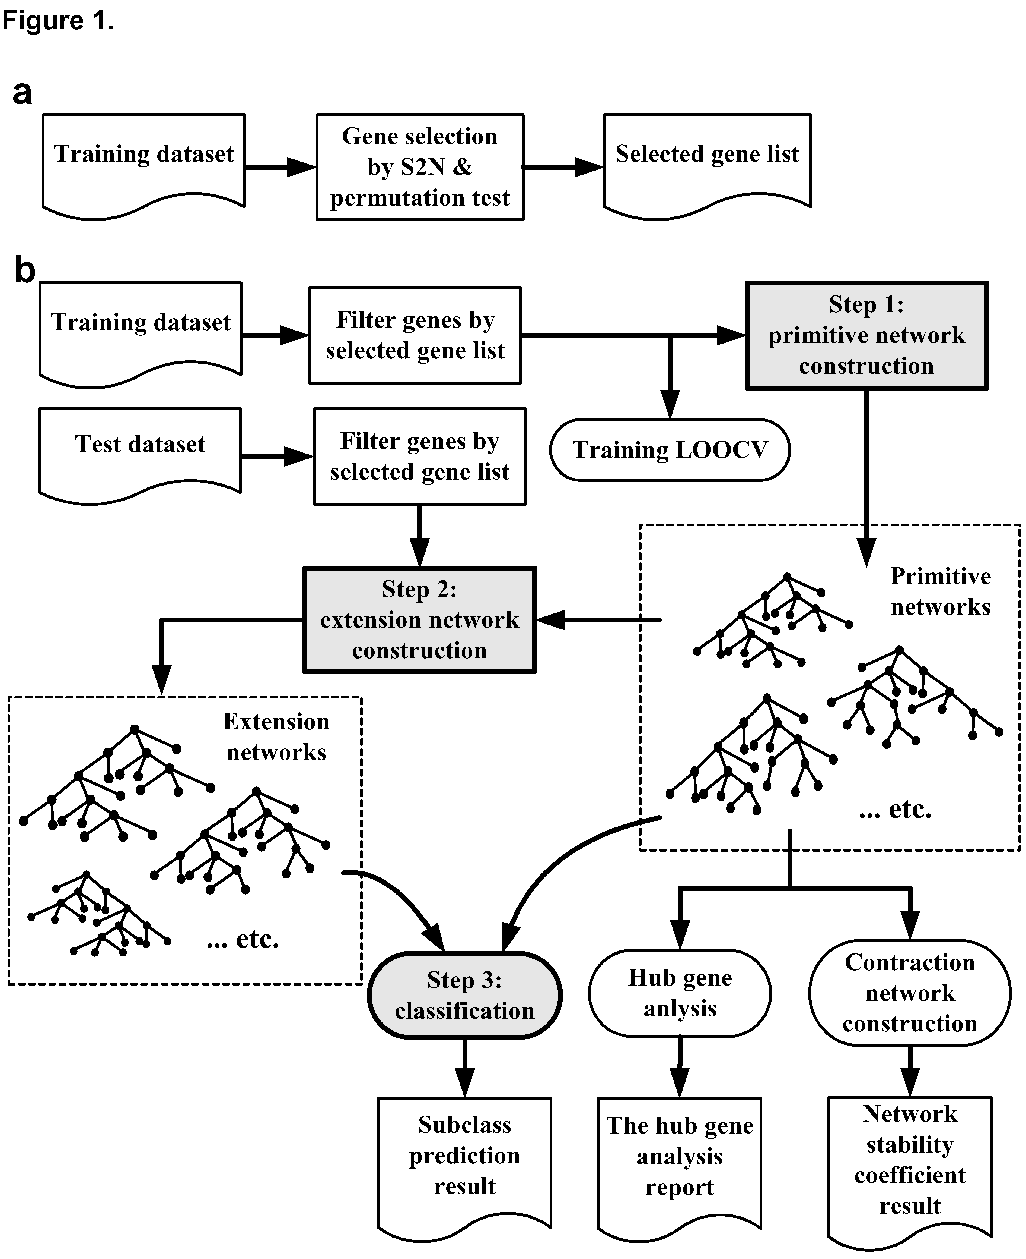
Used network topology to classify cancer
Chun-Chi Liu, et al. (2006)
Topology-based cancer classification and related pathway mining using microarray data.
Nucleic Acids Research 34: 4069-4080.
2011/6/3
12
12

Slide 13
Built the Composite Regulatory Signature Database (CRSD)
The composite regulatory signature database (CRSD) can be employed to identify or analyze:
  gene expression signatures (GESs)
  Significant enrichment with databases including
    miRNA regulatory signatures (MRSs)
    TF regulatory signatures (TRSs)
    GO/pathways
  Motif discovery
Web server: http://biochip.nchu.edu.tw/crsd1
Chun-Chi Liu, et al. (2006) CRSD: a comprehensive web server for composite regulatory signature discovery.
Nucleic Acids Research 34: W571-W577.
13
Notes:
13
Transcription factors (TFs) and microRNAs (miRNAs) play important roles in regulation of gene expression.

Slide 14

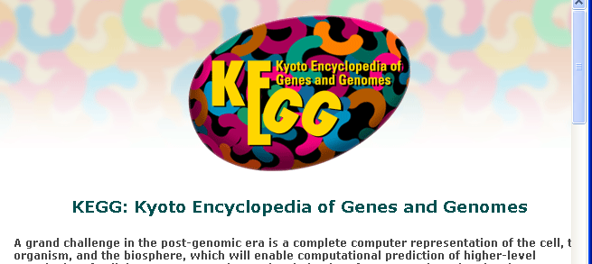

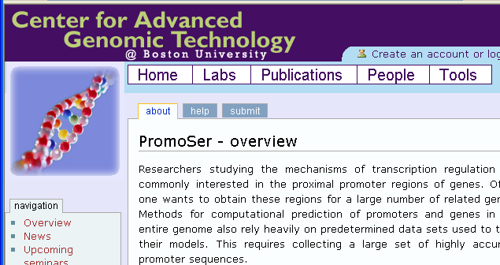
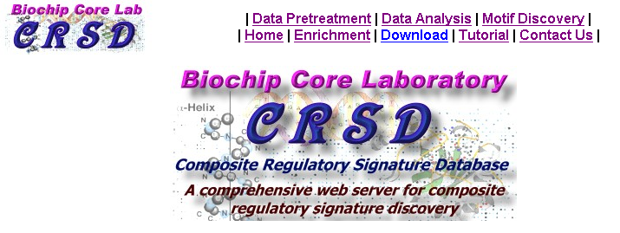
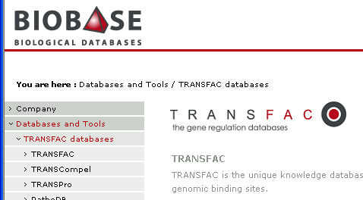
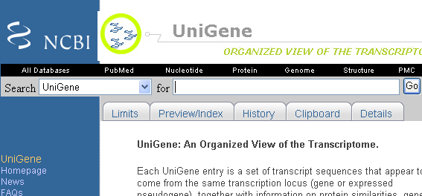
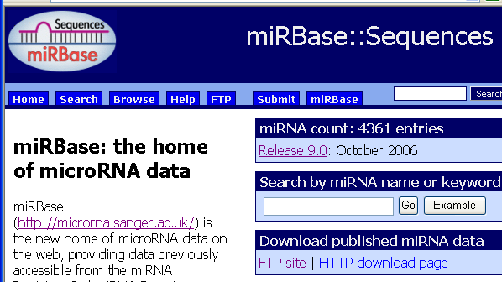
14
14
Notes:
14
廣泛型生物資訊網站

Slide 15
Developed the semi-supervised learning method with SVM and Manifold (Graph laplacian transformation)
Learn Manifold structure from all of samples (positive, negative, and unknown).
The correlation network of all samples will be constructed by Pearson correlation, and then Laplacian matrix can be constructed by the adjacency matrix of correlation network.
15
Notes:
15

Slide 16
Support vector machine (SVM)
SVM is to find an optimal hyperplane that can separate positive and negative samples.
There is an unknown sample located in the center that cannot be confidently classified.
16
Notes:
16
In this study, we used SVM and manifold.

Slide 17
Manifold projection and ManiSVM
The projection space is the span of the eigenvectors corresponding to the smallest eigenvalues.
The Manifold structure has high smoothness in the projection space.
We used SVM to find the optimal hyperplane to create a classifier. Now, the unknown samples are easy to classifier.
Chun-Chi Liu, et al. (2009) Integrative Disease Classification Based on Cross-platform Microarray Data.
BMC Bioinformatics 10:S25.
Notes:
17

Slide 18
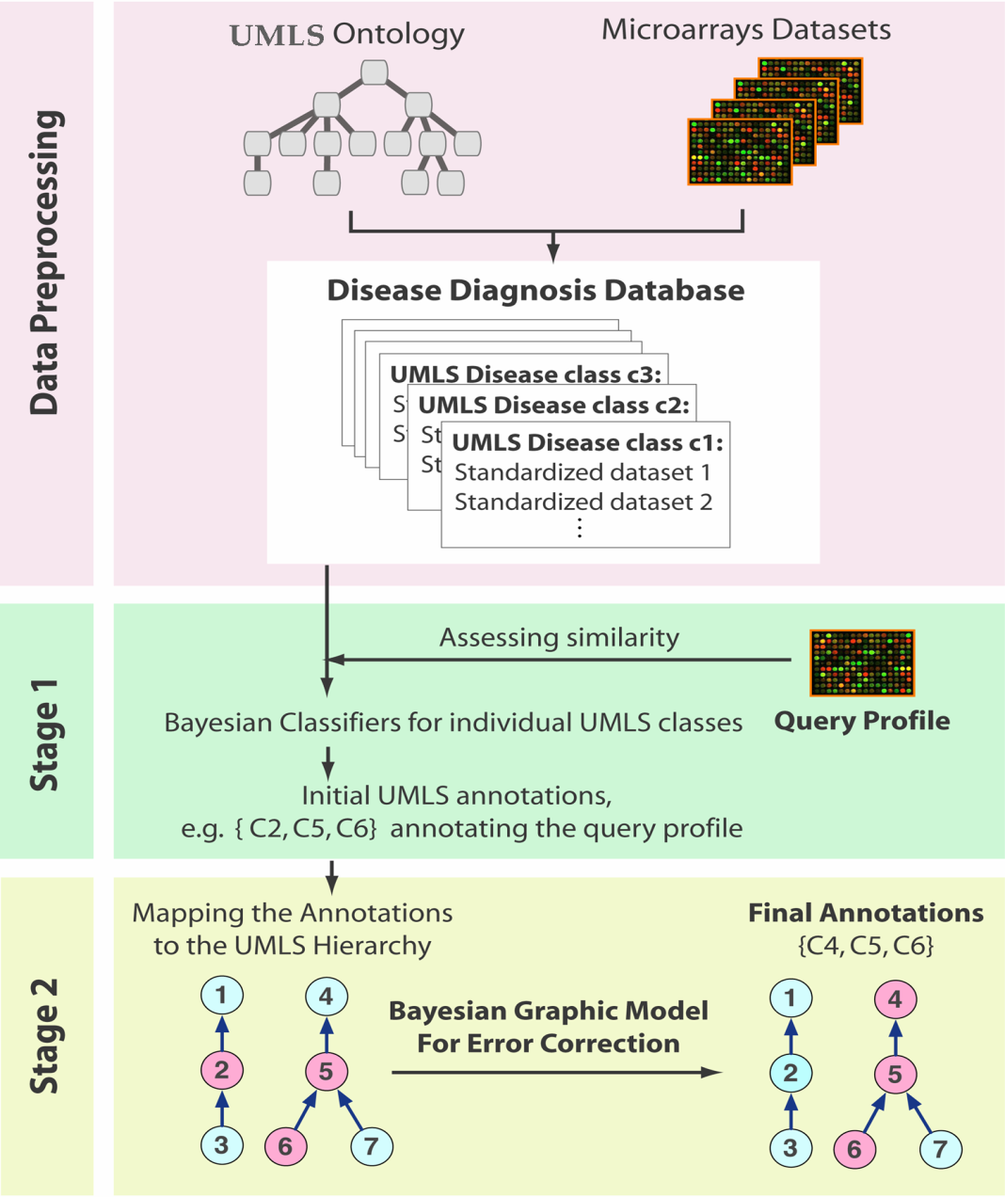
Used Bayesian approach to build Disease Diagnosis Database
Haiyan Huang, Chun-Chi Liu *, Xianghong Jasmine Zhou (2010) Bayesian Approach to Transforming Public Gene Expression Repositories into Disease Diagnosis Databases.
Proc. Natl. Acad. Sci. USA. 107: 6823-8. (*Joint first author)
18

Slide 19
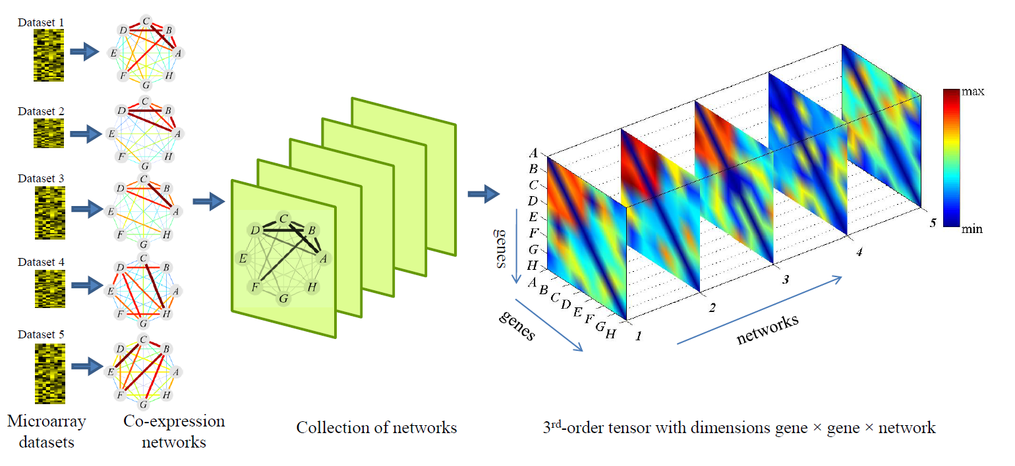
Pattern Discovery Across Many Weighted Coexpression Networks Using Tensor Computation
A collection of co-expression networks can be “stacked” together into a third-order tensor such that each slice represents the adjacency matrix of one network.
Wenyuan Li, Chun-Chi Liu, Tong Zhang, Haifeng Li, Michael Waterman, Xianghong Jasmine Zhou. (2011) Integrative Analysis of Many Weighted Coexpression Networks Using Tensor Computation. PLoS Computational Biology, in press

Slide 20
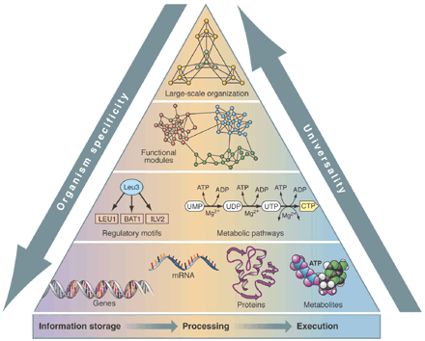
Systems biology
Systems biology is an approach integrated various biological systems.
Bioinformatics is
the integrating tool.
  systematic data
  analysis
  construction of
  biological models
(Z.N. Oltvai & A.L. Barabasi, Science 2002)
20
20
Notes:
Introduction to Systems Biology
系統生物學(systems biology)是一個需要整合多方面的生物系統，例如：基因體(genomics)、基因轉錄體(transcriptomics)、蛋白質體(proteomics)、基因調控網路(gene regulatory networks)、生物途徑(pathways)，並且以生物資訊(Bioinformatics)為整合工具，進行系統性的研究，其包含了資料分析與生物模型的建立。我將會探討幾個系統生物學典型的方法。
Systems biology is the study integrated various biological systems such as genomics, transcriptomics, proteomics, gene regulatory networks, and pathways, in which bioinformatics is an integrating tool to perform the systematic data analysis and the construction of biological models. In this talk, I will introduce several computational systems biology methods. These methods can be used in gene function prediction and protein-protein interaction prediction.

Slide 21
Gene function prediction
21
21

Slide 22
Gene function prediction
Network construction for gene function prediction
Co-expression: Gene expression data. Two genes are linked if their expression levels are similar across conditions in a gene expression study.
Physical Interaction: Protein-protein interaction data.
Genetic interaction: Genetic interaction data. Two genes are functionally associated if the effects of perturbing one gene were found to be modified by perturbations to a second gene.
Shared protein domains: Protein domain data. Two gene products are linked if they have the same protein domain.
Co-localization: Genes expressed in the same tissue, or proteins found in the same location.
Pathway: Pathway data. Two gene products are linked if they participate in the same reaction within a pathway.
22
22

Slide 23
GeneMANIA algorithm
23
23
23
GeneMANIA stands for Multiple Association Network Integration Algorithm (Mostafavi et al. Genome Biology 2008)
The GeneMANIA algorithm consists of two parts:
  A linear regression-based algorithm that calculates a single composite functional association network from multiple data sources.
  A label propagation algorithm for predicting gene function given the composite functional association network.
Notes:
GeneMANIA: a real-time multiple association network integration algorithm for predicting gene function
Mostafavi S, Ray D, Warde-Farley D, Grouios C, Morris Q (2008) Genome Biology 9: S4.
GeneMANIA treats gene function prediction as a binary classification problem. As such, each functional association network derived from the data sources is assigned a positive weight, reflecting the data sources' usefulness in predicting the function. The weighted average of the association networks is constructed into a function-specific association network. GeneMANIA uses separate objective functions to fit the weights; this simplifies the optimization problem and decreases the run time.
GeneMANIA predicts gene function from the composite network using a variation of the Gaussian field label propagation algorithm that is appropriate for gene function prediction in which there are typically relatively few positive examples. Label propagation algorithms assign a score (the discriminant value) to each node in the network. This score reflects the computed strength of association that the node has to the seed list defining the given function. This value can be thresholded to enable predictions of a given gene function.
23

Slide 24
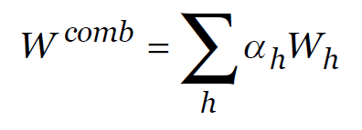
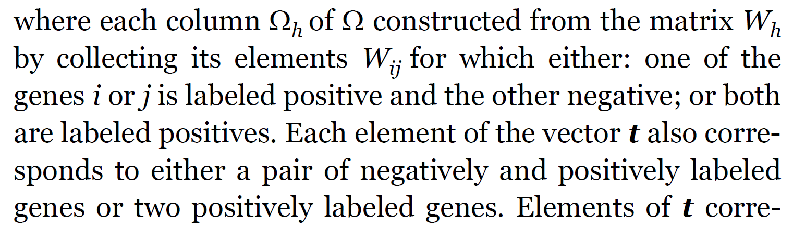
Network combination by using ridge regression
where α is the vector of network weighs.
t is the target vector.
(Mostafavi et al. Genome Biology 2008)
24
24
24

Slide 25
Example
~
+
+
W ~ W1 + W2 + W3
W = 0.6 W1 + 0.4 W2 + 0.4 W3
1
0.8
=
+
+
0.4
1
0.4
25
Notes:
2
25

Slide 26
Positive and negative label
Positive label
Negative label
26

Slide 27
Ridge Regression
Ridge regression shrinks the regression coefficients by imposing a penalty on their size. Thus, ridge coefficients minimize a penalized RSS.
Larger λ means greater shrinkage.
Alternatively:
There is one-to-one correspondence between s and λ.
Notes:
27
Lambda >=0 controls the amount of shrinkage. The larger the lambda, the greater the shrinkage.

Slide 28
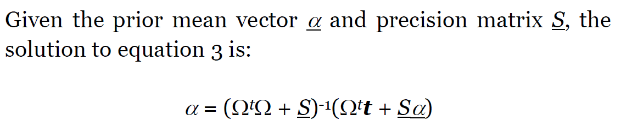

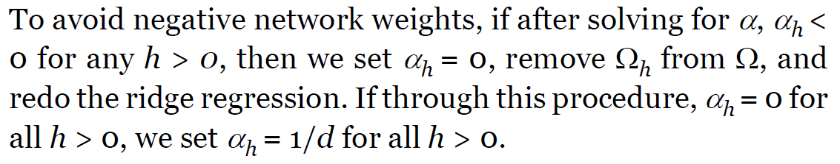
The solution
(Mostafavi et al. Genome Biology 2008)
28
28

Slide 29

Trace (linear algebra)
In linear algebra, the trace of an n-by-n square matrix A is defined to be the sum of the elements on the main diagonal (the diagonal from the upper left to the lower right) of A, i.e.,
http://en.wikipedia.org/wiki/Trace_(linear_algebra)
29
29

Slide 30
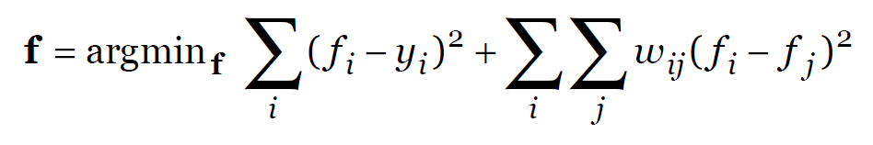

Label propagation algorithm
y is the training label vector
f is the predicted label
w_{ij} is the association between gene i and j
L = D – W is the graph Laplacian matrix
(Mostafavi et al. Genome Biology 2008)
30
30

Slide 31
i
j
Notes:
fi

Slide 32
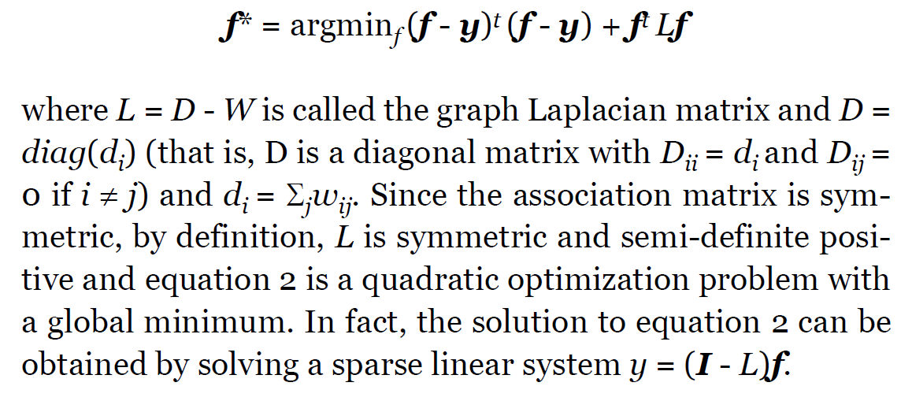
Solving a sparse linear system
(Mostafavi et al. Genome Biology 2008)
32
32

Slide 33
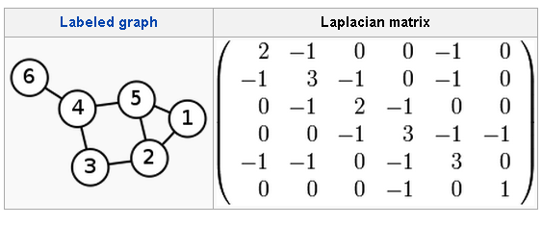
Laplacian matrix
http://en.wikipedia.org/wiki/Laplacian_matrix
33
33

Slide 34
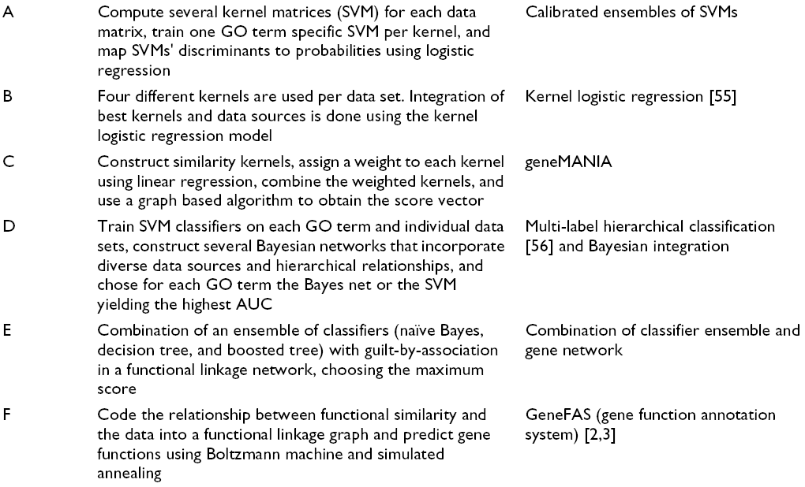
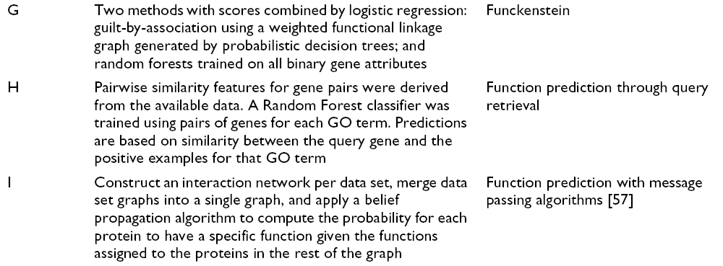
The comparison of 9 methods
(Peña-Castillo et al. Genome Biology 2008)

Slide 35
GeneMANIA performance (C)
(Peña-Castillo et al. Genome Biology 2008)
35

Slide 36
Thank you!
36

