Slide 1
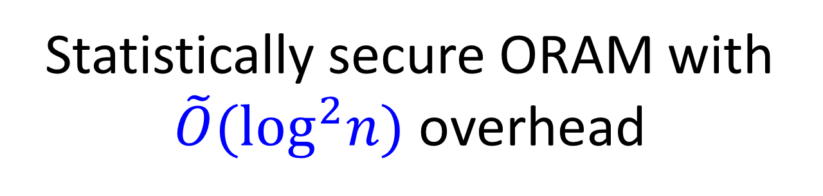
Statistically secure ORAM with $\tilde{O}({\text{log}}^{2}n)$ overhead
Kai-Min Chung (Academia Sinica)
joint work with
Zhenming Liu (Princeton) and Rafael Pass (Cornell NY Tech)
Notes:
JaHestep

Slide 2

Oblivious RAM [G87,GO96]
sequence of addresses accessed by CPU
Compile RAM program to protect data privacy
  Store encrypted data
  Main challenge: Hide access pattern
Secure zone
Main memory:
a size-n array of memory cells (words)
q_{i}
CPU
Read/Write
E.g., access pattern for binary search leaks rank of searched item
CPU cache:
small private memory
M[q_{i}]

Slide 3




Cloud Storage Scenario
Access data from the cloud
Encrypt the data
Alice
Hide the access pattern
Bob
is curious

Slide 4
Oblivious RAM—hide access pattern
Design an oblivious data structure implements
  a big array of n memory cells with
  Read(addr) & Write(addr, val) functionality
Goal: hide access pattern
Notes:
Any way safer:
Secret sharing.
Multi-party save the value.
O-RAM.
Primitive?
This is crucial for statistically secure multi-party computation.
This is (own its own) useful in other application beyond ORAM context.

Slide 5
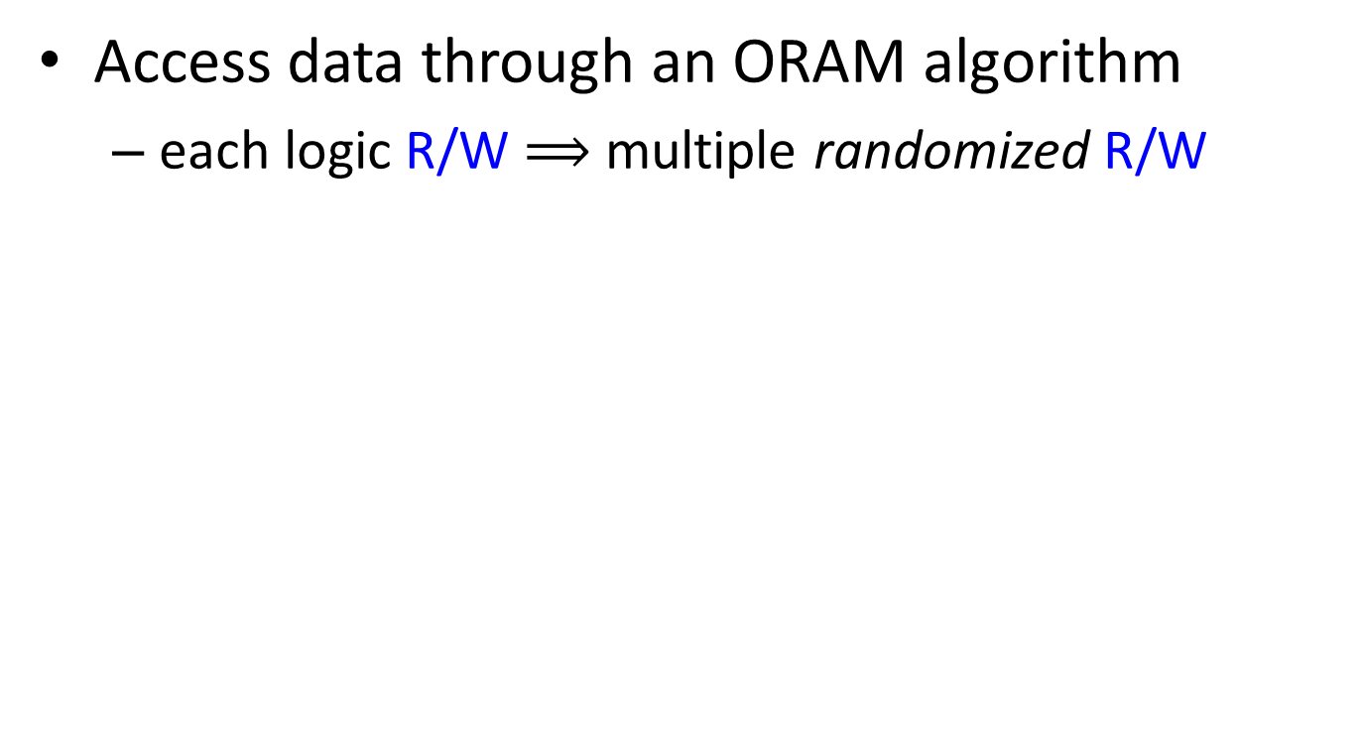
Illustration
Access data through an ORAM algorithm
  each logic R/W $⟹$ multiple randomized R/W
ORAM
structure
ORead/OWrite
Multiple
Read/Write
ORAM
algorithm
Alice
Bob

Slide 6
Oblivious RAM—hide access pattern
Design an oblivious data structure implements
  a big array of n memory cells with
  Read(addr) & Write(addr, val) functionality
Goal: hide access pattern
  For any two sequences of Read/Write operations Q₁, Q₂ of equal length, the access patterns are
    statistically / computationally indistinguishable
Notes:
Any way safer:
Secret sharing.
Multi-party save the value.
O-RAM.
Primitive?
This is crucial for statistically secure multi-party computation.
This is (own its own) useful in other application beyond ORAM context.

Slide 7


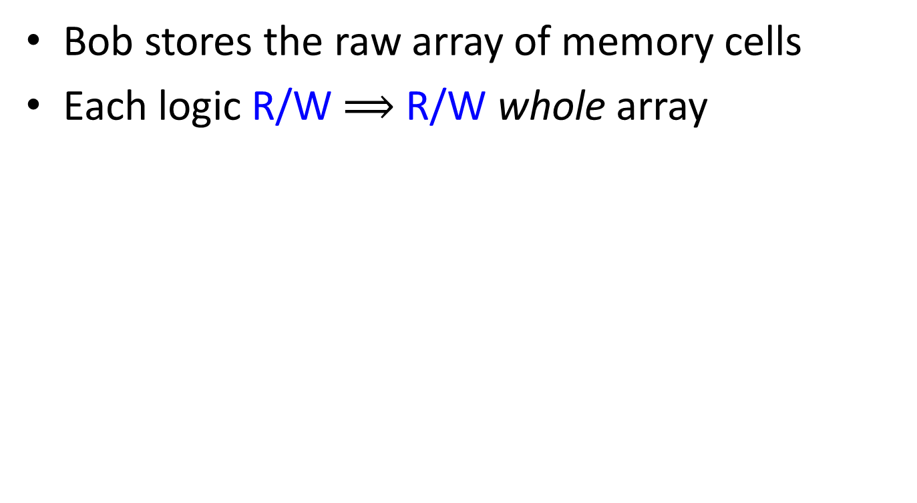
A Trivial Solution
Bob stores the raw array of memory cells
Each logic R/W $⟹$ R/W whole array
ORAM
structure
Perfectly secure
But has O(n) overhead
ORead/OWrite
Multiple
Read/Write
ORAM
algorithm
Alice
Bob

Slide 8
ORAM complexity
Time overhead
  time complexity of ORead/OWrite
Space overhead
  ( size of ORAM structure / n )
Cache size
Security
  statistical vs. computational
Name | Security | Time overhead | Space overhead | Cache size
Trivial sol. | Perfect | n | 1 | O(1)

Slide 9

A successful line of research
Many works in literature; a partial list below:
Reference | Security | Time overhead | Space overhead | Cache size
Trivial sol. | Perfect | n | 1 | O(1)
Goldreich & Ostrovsky | Computational | polylog(n) | polylog(n) | O(1)
Ajtai | Statistical | polylog(n) | polylog(n) | O(1)
Kushilevitz, Lu, & Ostrovsky | Computational | O(log²n/log log n) | O(1) | O(1)
Shi, Chan, Stefanov, and Li | Statistical | O(log³n) | O(log n) | O(1)
Stefanov & Shi | Statistical | no analysis | O(1) | no analysis
Question: can statistical security & $\tilde{O}\left({\text{log}}^{2}n\right)$ overhead be achieved simultaneously?

Slide 10
Why statistical security?
We need to encrypt data, which is only computationally secure anyway. So, why statistical security?
Ans 1: Why not? It provides stronger guarantee, which is better.
Ans 2: It enables new applications!
  Large scale MPC with several new features [BCP14]
    emulate ORAM w/ secret sharing as I.T.-secure encryption
    require stat. secure ORAM to achieve I.T.-secure MPC

Slide 11
Our Result
Theorem: There exists an ORAM with
  Statistical security
  O(log²n loglog n) time overhead
  O(1) space overhead
  polylog(n) cache size
Independently, Stefanov et al. [SvDSCFRYD’13] achieve statistical security with O(log²n) overhead with different algorithm & very different analysis

Slide 12
Tree-base ORAM framework of [SCSL’10]

Slide 13
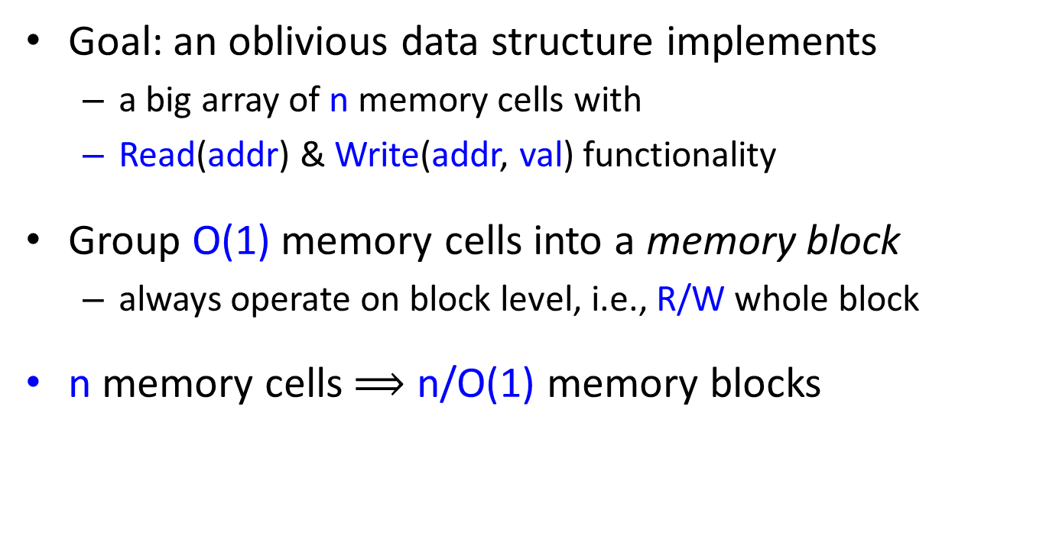
A simple initial step
Goal: an oblivious data structure implements
  a big array of n memory cells with
  Read(addr) & Write(addr, val) functionality
Group O(1) memory cells into a memory block
  always operate on block level, i.e., R/W whole block
n memory cells $⟹$ n/O(1) memory blocks

Slide 14
Tree-base ORAM Framework [SCSL’10]
ORAM structure
Data is stored in a complete binary tree with n leaves
  each node has a bucket of size L to store up to L memory blocks
A position map Pos in CPU cache indicate position of each block
  Invariant 1: block i is stored somewhere along path from root to Pos[i]
Bucket Size = L
1
2
3
4
5
6
7
8
…
CPU cache:
Position map Pos
1 | 3 | 7 | 1 | 4 | 2 | 6 | 3 | 1

Slide 15
Tree-base ORAM Framework [SCSL’10]
ORAM structure
Invariant 1: block i can be found along path from root to Pos[i]
Bucket Size = L
ORead( block i ):
Fetch block i along path from root to Pos[i]
1
2
3
4
5
6
7
8
…
CPU cache:
Position map Pos
1 | 3 | 7 | 1 | 4 | 2 | 6 | 3 | 1

Slide 16
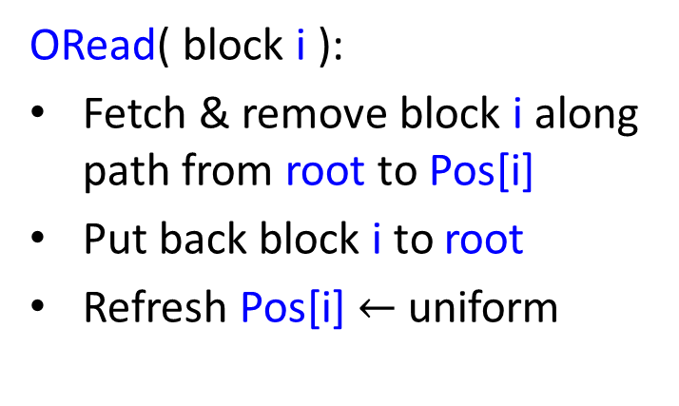
Tree-base ORAM Framework [SCSL’10]
ORAM structure
Invariant 1: block i can be found along path from root to Pos[i]
Bucket Size = L
Invariant 2: Pos[.] i.i.d. uniform given access pattern so far
ORead( block i ):
Fetch & remove block i along path from root to Pos[i]
Put back block i to root
Refresh Pos[i] $←$ uniform
1
2
3
4
5
6
7
8
…
CPU cache:
Position map Pos
Access pattern = random path
Issue: overflow at root
4
1 | 3 | 7 | 1 | 4 | 2 | 6 | 3 | 1

Slide 17
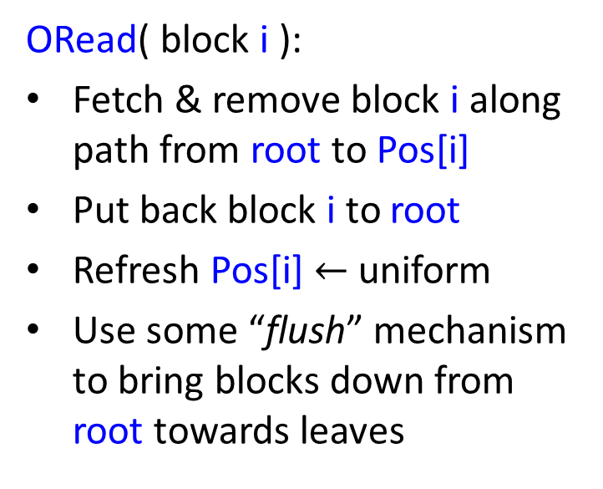
Tree-base ORAM Framework [SCSL’10]
ORAM structure
Invariant 1: block i can be found along path from root to Pos[i]
Bucket Size = L
Invariant 2: Pos[.] i.i.d. uniform given access pattern so far
ORead( block i ):
Fetch & remove block i along path from root to Pos[i]
Put back block i to root
Refresh Pos[i] $←$ uniform
Use some “flush” mechanism to bring blocks down from root towards leaves
1
2
3
4
5
6
7
8
…
CPU cache:
Position map Pos
1 | 3 | 7 | 1 | 4 | 2 | 6 | 3 | 1

Slide 18
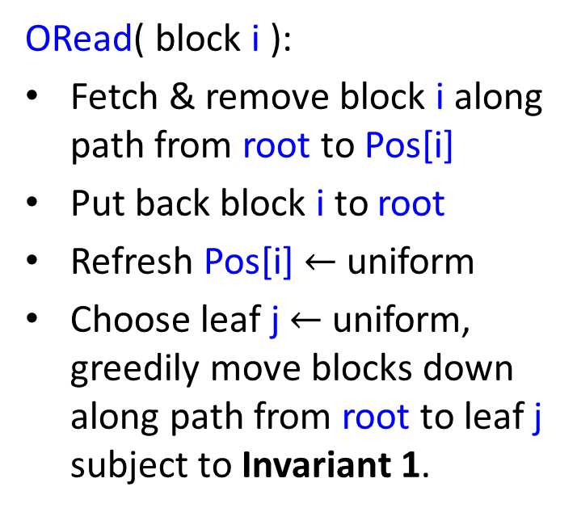
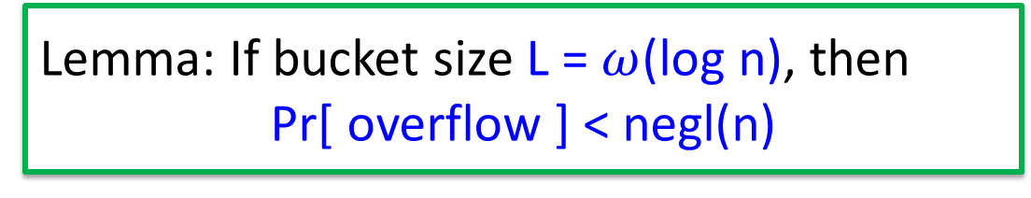
Flush mechanism of [CP’13]
ORAM structure
Invariant 1: block i can be found along path from root to Pos[i]
Bucket Size = L
Invariant 2: Pos[.] i.i.d. uniform given access pattern so far
ORead( block i ):
Fetch & remove block i along path from root to Pos[i]
Put back block i to root
Refresh Pos[i] $←$ uniform
Choose leaf j $←$ uniform, greedily move blocks down along path from root to leaf j subject to Invariant 1.
Lemma: If bucket size L = $ω$(log n), then
Pr[ overflow ] < negl(n)
1
2
3
4
5
6
7
8
…
CPU cache:
Position map Pos
1 | 3 | 7 | 1 | 4 | 2 | 6 | 3 | 1

Slide 19

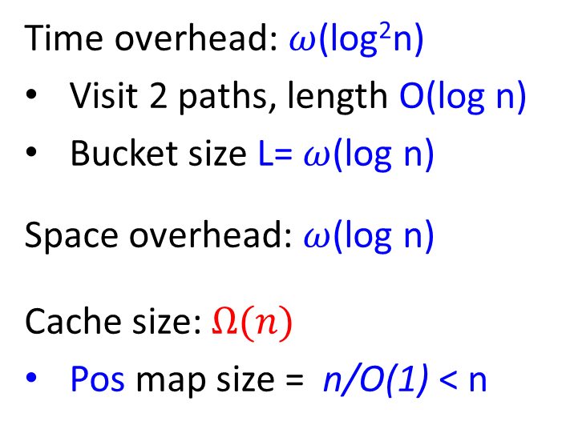
Complexity
ORAM structure
Time overhead: $ω$(log²n)
Visit 2 paths, length O(log n)
Bucket size L= $ω$(log n)
Space overhead: $ω$(log n)
Cache size: $Ω(n)$
Pos map size = n/O(1) < n
Bucket Size L= $ω$(log n)
1
2
3
4
5
6
7
8
Final idea: outsource Pos map using this ORAM recursively
O(log n) level recursions bring Pos map size down to O(1)
…
CPU cache:
Position map Pos
1 | 3 | 7 | 1 | 4 | 2 | 6 | 3 | 1

Slide 20
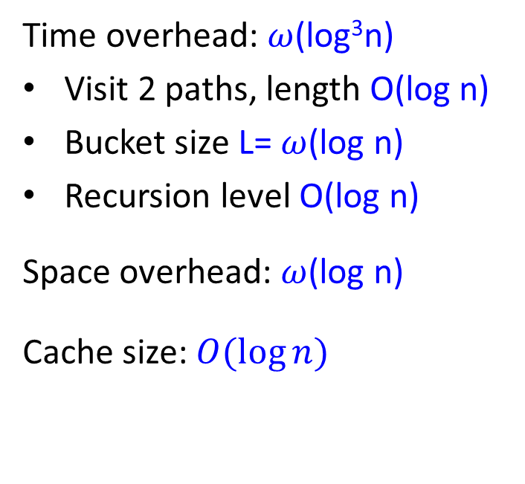
Complexity
ORAM structure
Time overhead: $ω$(log³n)
Visit 2 paths, length O(log n)
Bucket size L= $ω$(log n)
Recursion level O(log n)
Space overhead: $ω$(log n)
Cache size: $O(\log{n})$
Bucket Size L= $ω$(log n)
1
2
3
4
5
6
7
8
…
CPU cache:
Position map Pos
1 | 3 | 7 | 1 | 4 | 2 | 6 | 3 | 1

Slide 21
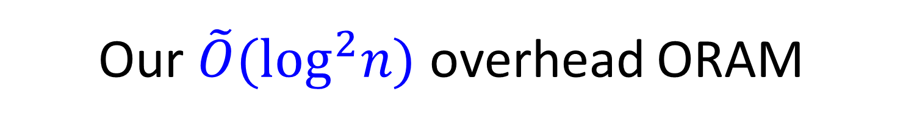
Our $\tilde{O}({\text{log}}^{2}n)$ overhead ORAM

Slide 22

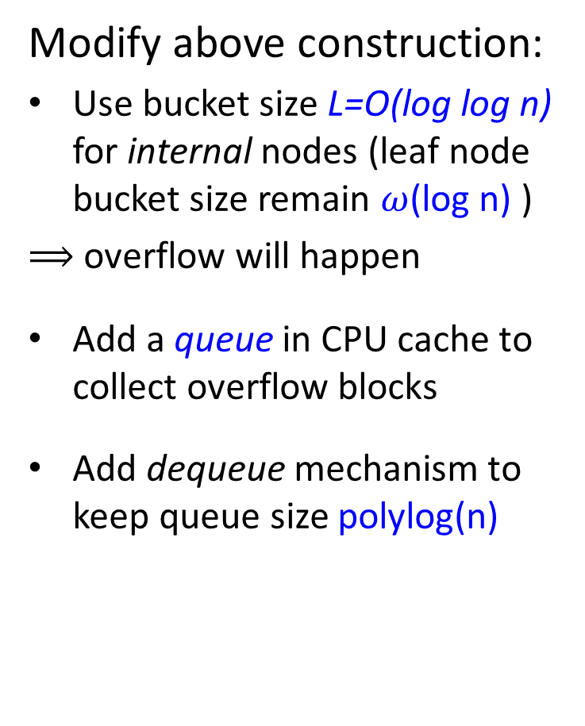
Our Construction—High Level
ORAM structure
Modify above construction:
Use bucket size L=O(log log n) for internal nodes (leaf node bucket size remain $ω$(log n) )
$⟹$ overflow will happen
Add a queue in CPU cache to collect overflow blocks
Add dequeue mechanism to keep queue size polylog(n)
L= $O$(loglog n)
This saves a factor of log n
1
2
3
4
5
6
7
8
…
CPU cache: (in addition to Pos map)
Invariant 1: block i can be found (i) in queue, or
(ii) along path from root to Pos[i]
queue:

Slide 23
Our Construction—High Level
ORAM structure
Read( block i ):
L= $O$(loglog n)
Fetch
Put back
Flush
×Geom(2)
1
2
3
4
5
6
7
8
Put back
…
CPU cache: (in addition to Pos map)
Flush
×Geom(2)
queue:

Slide 24
Our Construction—Details
ORAM structure
Fetch:
Fetch & remove block i from either queue or path to Pos[i]
Insert it back to queue
Put back:
Pop a block out from queue
Add it to root
L= $O$(loglog n)
1
2
3
4
5
6
7
8
…
CPU cache: (in addition to Pos map)
queue:

Slide 25
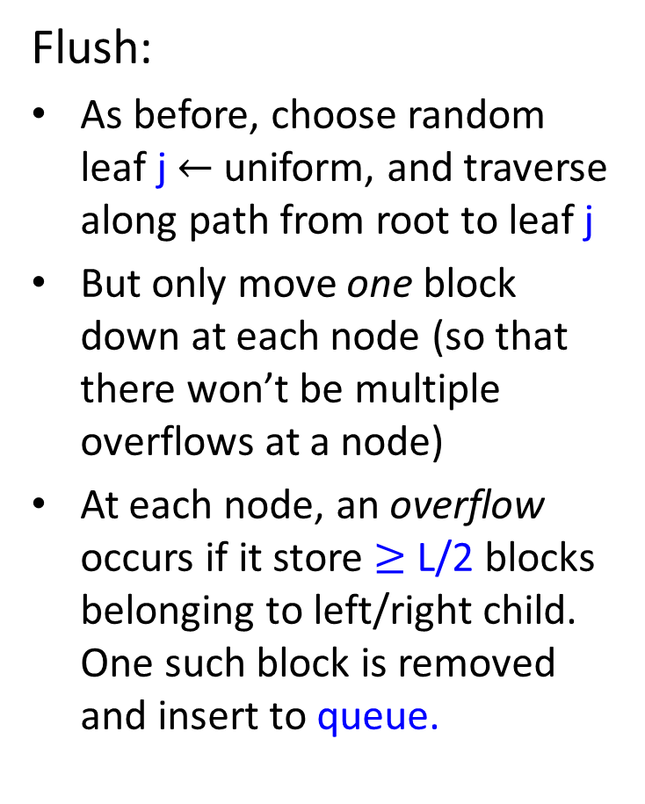
Our Construction—Details
ORAM structure
Flush:
As before, choose random leaf j $←$ uniform, and traverse along path from root to leaf j
But only move one block down at each node (so that there won’t be multiple overflows at a node)
At each node, an overflow occurs if it store $≥$ L/2 blocks belonging to left/right child. One such block is removed and insert to queue.
L= $O$(loglog n)
Select greedily: pick the one can move farthest
1
2
3
4
5
6
7
8
…
Alternatively, can be viewed as 2 buckets of size L/2
CPU cache: (in addition to Pos map)
queue:

Slide 26
Our Construction—Review
ORAM structure
ORead( block i ):
L= $O$(loglog n)
Fetch
Put back
Flush
×Geom(2)
1
2
3
4
5
6
7
8
Put back
…
CPU cache: (in addition to Pos map)
Flush
×Geom(2)
queue:

Slide 27
Security
ORAM structure
Invariant 1: block i can be found (i) in queue, or
(ii) along path from root to Pos[i]
L= $O$(loglog n)
Invariant 2: Pos[.] i.i.d. uniform given access pattern so far
Access pattern =
1 + 2*Geom(2) random paths
1
2
3
4
5
6
7
8
…
CPU cache: (in addition to Pos map)
queue:

Slide 28
Main Challenge—Bound Queue Size
Change of queue size
ORead( block i ):
Increase by 1, +1
Fetch
Put back
Main Lemma:
Pr[ queue size ever > log²n loglogn ] < negl(n)
Decrease by 1, -1
May increase many, +??
Flush
×Geom(2)
Queue size may blow up?!
Put back
CPU cache: (in addition to Pos map)
Flush
×Geom(2)
queue:

Slide 29
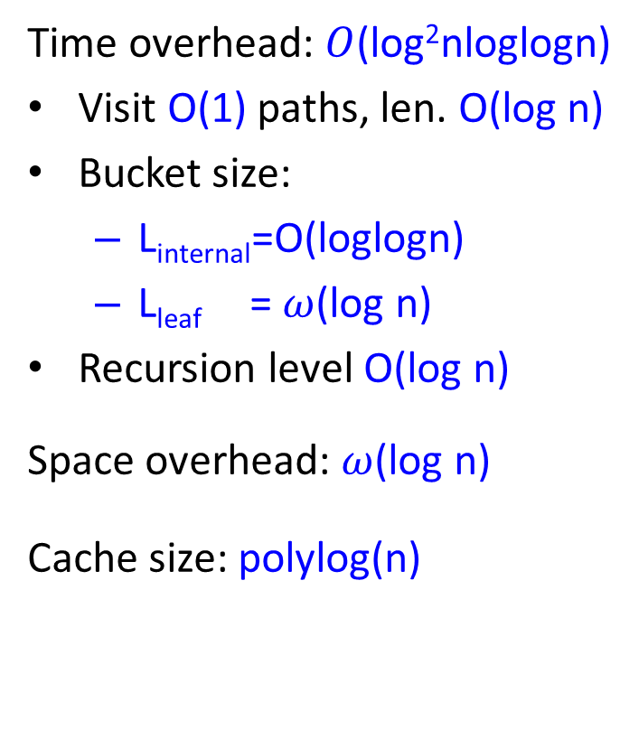
Complexity
ORAM structure
Time overhead: $O$(log²nloglogn)
Visit O(1) paths, len. O(log n)
Bucket size:
  L_{internal}=O(loglogn)
  L_{leaf} = $ω$(log n)
Recursion level O(log n)
Space overhead: $ω$(log n)
Cache size: polylog(n)
Bucket Size L= $ω$(log n)
1
2
3
4
5
6
7
8
…
CPU cache: (in addition to Pos map)
queue:

Slide 30

Main Lemma:
Pr[ queue size ever > log²n loglogn ] < negl(n)
Reduce analyzing ORAM to supermarket prob.:
  D cashiers in supermarket w/ empty queues at t=0
  Each time step
    With prob. p, arrival event occur: one new customer select a random cashier, who’s queue size +1
    With prob. 1-p, serving event occur: one random cashier finish serving a customer, and has queue size -1
  Customer upset if enter a queue of size > k
  How many upset customers in time interval [t, t+T]?

Slide 31
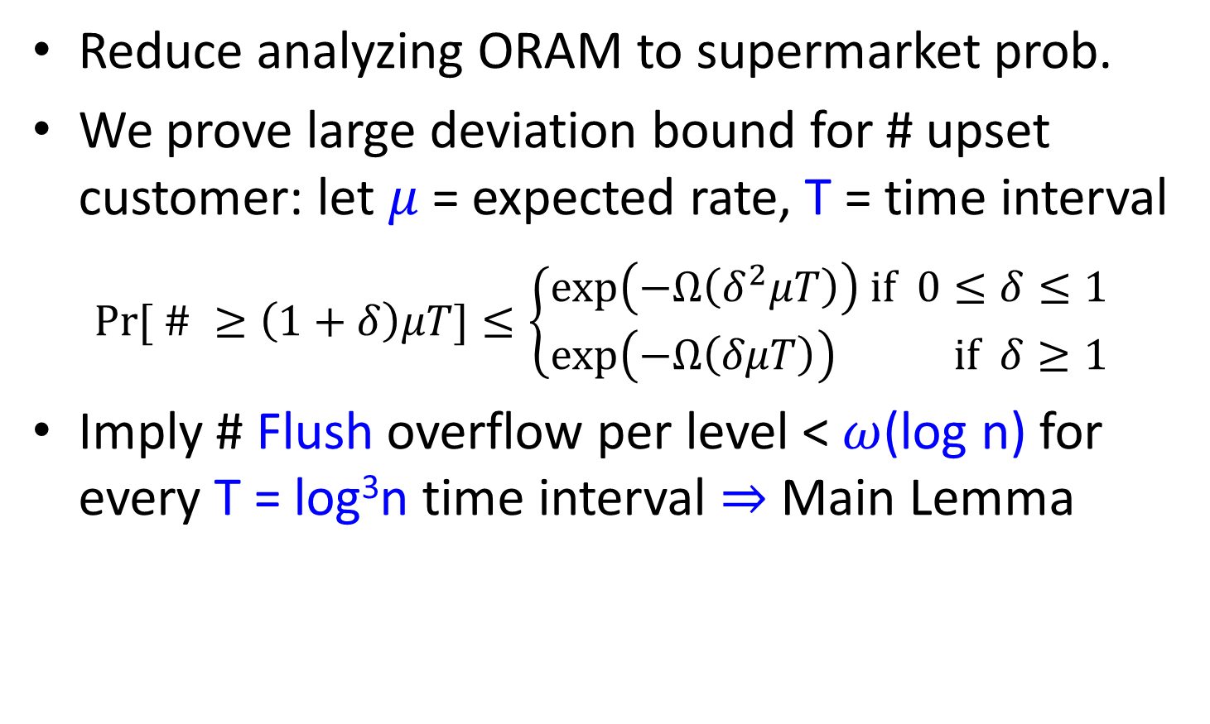
Main Lemma:
Pr[ queue size ever > log²n loglogn ] < negl(n)
Reduce analyzing ORAM to supermarket prob.
We prove large deviation bound for # upset customer: let $μ$ = expected rate, T = time interval
  $Pr⁡[ \# ≥\left(1+δ\right)μT]≤\left\{\begin{aligned}\exp\left(−Ω\left(δ^{2}μT\right)\right) \text{if} 0≤δ≤1 \\ \exp\left(−Ω\left(δμT\right)\right) \text{if} δ≥1\end{aligned} \right.$
Imply # Flush overflow per level < $ω$(log n) for every T = log³n time interval $⇒$ Main Lemma
Proved by using Chernoff bound for Markov chain with “resets” (generalize [CLLM’12])

Slide 32
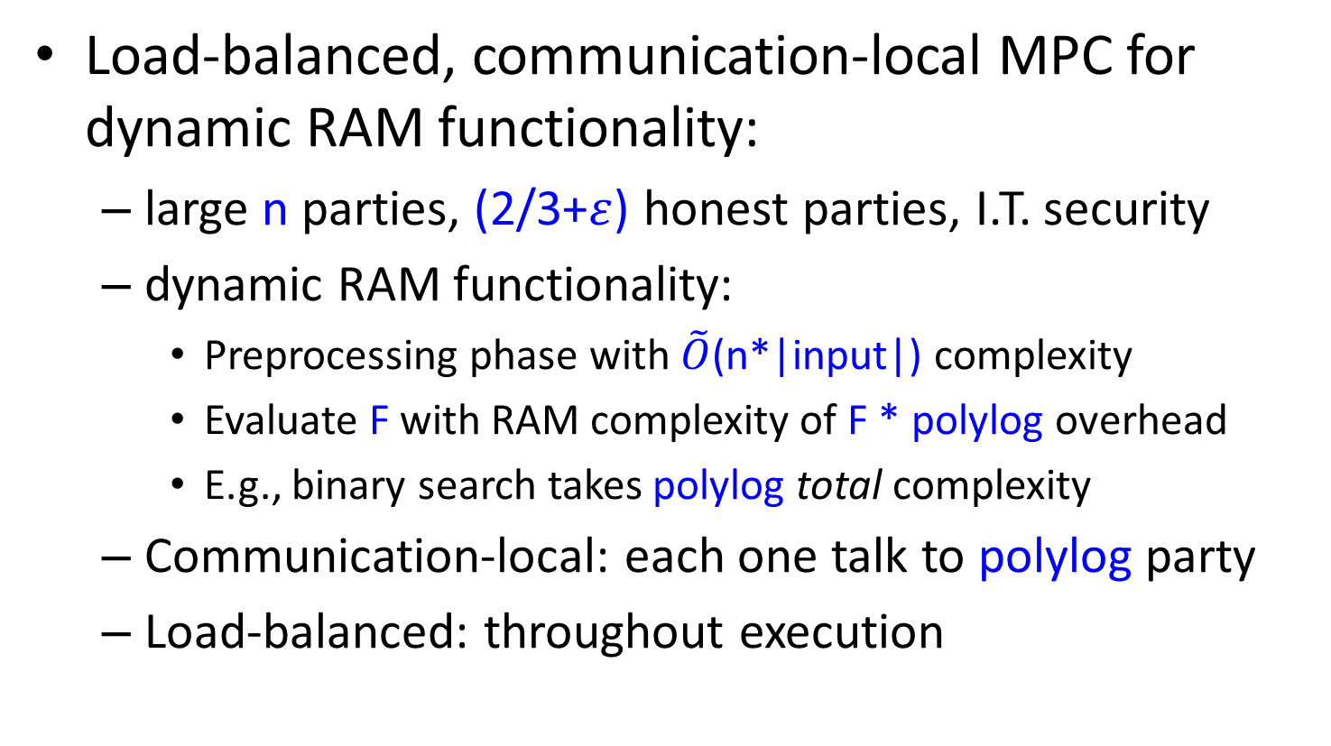
Application of stat. secure ORAM:
Large-scale MPC [BCP’14]
Load-balanced, communication-local MPC for dynamic RAM functionality:
  large n parties, (2/3+$ε$) honest parties, I.T. security
  dynamic RAM functionality:
    Preprocessing phase with $\tilde{O}$(n*|input|) complexity
    Evaluate F with RAM complexity of F * polylog overhead
    E.g., binary search takes polylog total complexity
  Communication-local: each one talk to polylog party
  Load-balanced: throughout execution
Require one broadcast in preprocessing phase.
(1-$δ$) Time(total) – polylog(n) < Time(P_{i}) < (1+$δ$) Time(total) + polylog(n)
Notes:
JaHestep

Slide 33
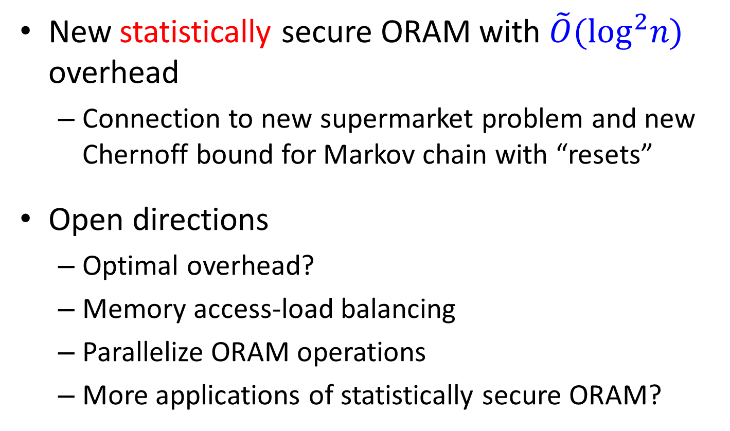
Conclusion
New statistically secure ORAM with $\tilde{O}({\text{log}}^{2}n)$ overhead
  Connection to new supermarket problem and new Chernoff bound for Markov chain with “resets”
Open directions
  Optimal overhead?
  Memory access-load balancing
  Parallelize ORAM operations
  More applications of statistically secure ORAM?

Slide 34
Thank you! Questions?

Slide 36
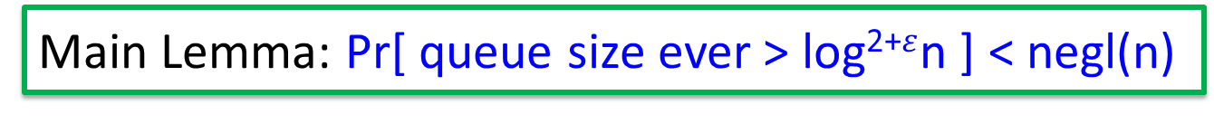
Main Lemma: Pr[ queue size ever > log²⁺$ε$n ] < negl(n)
Increase by 1, +1
Fetch
Decrease by 1, -1
Put back
May increase many, +??
Flush
×Geom(2)
Decrease by 1, -1
Put back
May increase many, +??
Flush
×Geom(2)

Slide 37
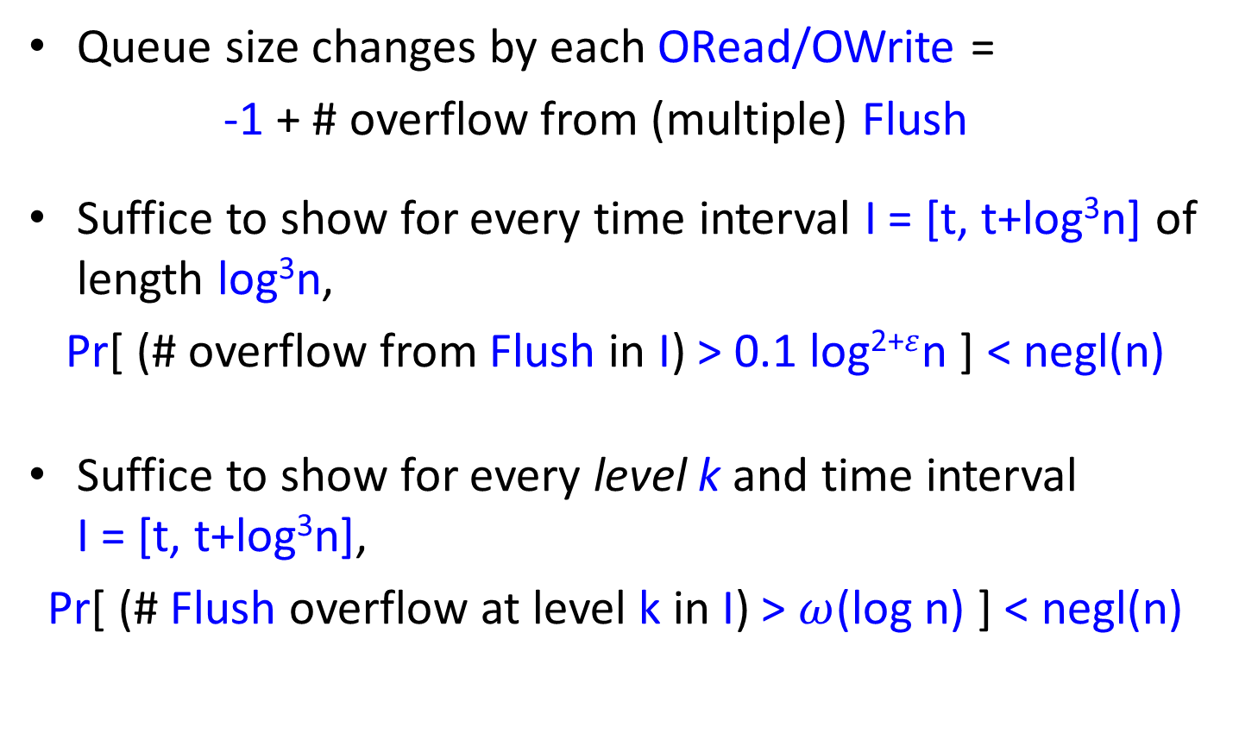
Main Lemma: Pr[ queue size ever > log²⁺$ε$n ] < negl(n)
Queue size changes by each ORead/OWrite =
-1 + # overflow from (multiple) Flush
Suffice to show for every time interval I = [t, t+log³n] of length log³n,
Pr[ (# overflow from Flush in I) > 0.1 log²⁺$ε$n ] < negl(n)
Suffice to show for every level k and time interval I = [t, t+log³n],
Pr[ (# Flush overflow at level k in I) > $ω$(log n) ] < negl(n)

Slide 38
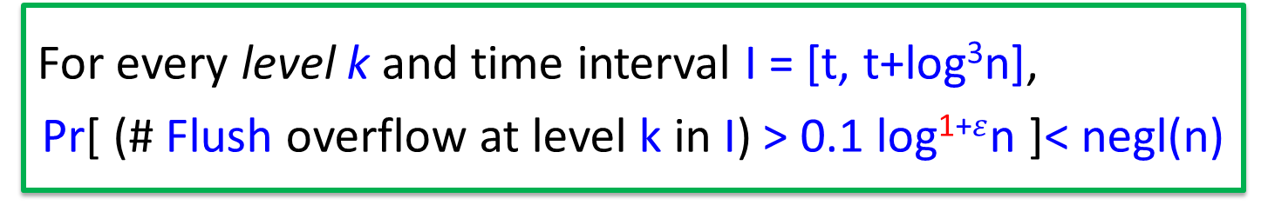
For every level k and time interval I = [t, t+log³n],
Pr[ (# Flush overflow at level k in I) > 0.1 log¹⁺$ε$n ]< negl(n)
A complete binary tree with n leaves to store data
  Each node has a bucket to store up to L blocks
A position map Pos in CPU cache indicate position of each block
L= $O$(loglog n)
1
2
3
4
5
6
7
8
…

Slide 39
Tree-base ORAM Framework [SCSL’10]
ORAM structure
A complete binary tree with n leaves to store data
  Each node has a bucket to store up to L blocks
A position map Pos in CPU cache indicate position of each block
Bucket Size = L
1
2
3
4
5
6
7
8
…
Invariant: block i can be found along path from root to Pos[i]
CPU cache:
Pos
1 | 3 | 7 | 1 | 4 | 2 | 6 | 3 | 1

Slide 40
Conclusion
A new statistically secure ORAM construct with O(log² n log log n) overhead.
Introduced supermarket model.
Introduced Chernoff bound with resets?
Can we get rid of log log n?
Seems not, because we ignore correlations across different levels and thus a union bound is needed.

