Slide 1

Sampling and Summarization for BIG Network Data
Mi-Yen Yeh 葉彌妍
Associate Research Fellow
Institute of Information Science, Academia Sinica
miyen@iis.sinica.edu.tw

Slide 2












Examples of Big Complex Network
http://teamarin.net/2013/12/27/connected-devices-accelerate-the-need-for-ipv6-in-the-internet-of-things/
http://betanews.com/2013/04/30/the-way-we-were-cern-recreates-the-first-website/

Slide 3
Why Network Data Big?
Social media and social network activities, internet of things, multimedia
  Three primary sources of big data, McKinsey Global Institute, 2011
3-V Characteristics
  Volume: millions to billions of nodes and edges
  Velocity: the network grows and changes quickly
  Variety: different node types, different link types, rich data attributes, rich information hidden

Slide 4


Volume
> 1 billion users
> 500 million users
> 500 million tweets per day
https://blog.twitter.com/2013/new-tweets-per-second-record-and-how
>200 million users

Slide 5
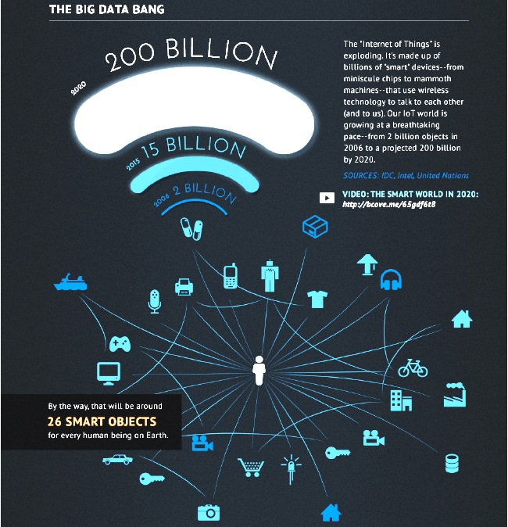
Volume
http://www.intel.com/content/www/us/en/intelligent-systems/iot/internet-of-things-infographic.html

Slide 6
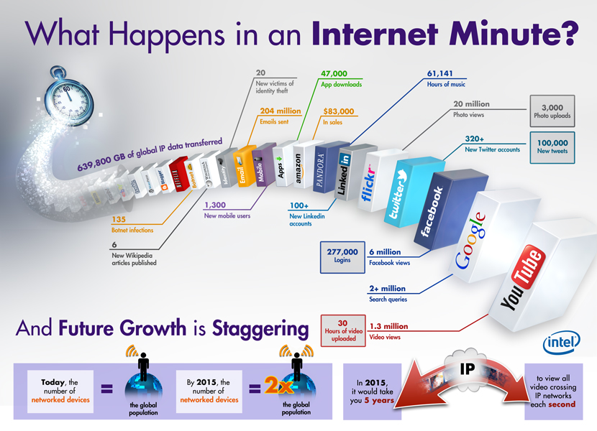
Velocity
by Intel.com 2012.03
Notes:
What happens in an Internet minute? Today, the number of networked devices is equal to the global population. By 2015, the number of networked devices will be twice the global population.

Slide 7
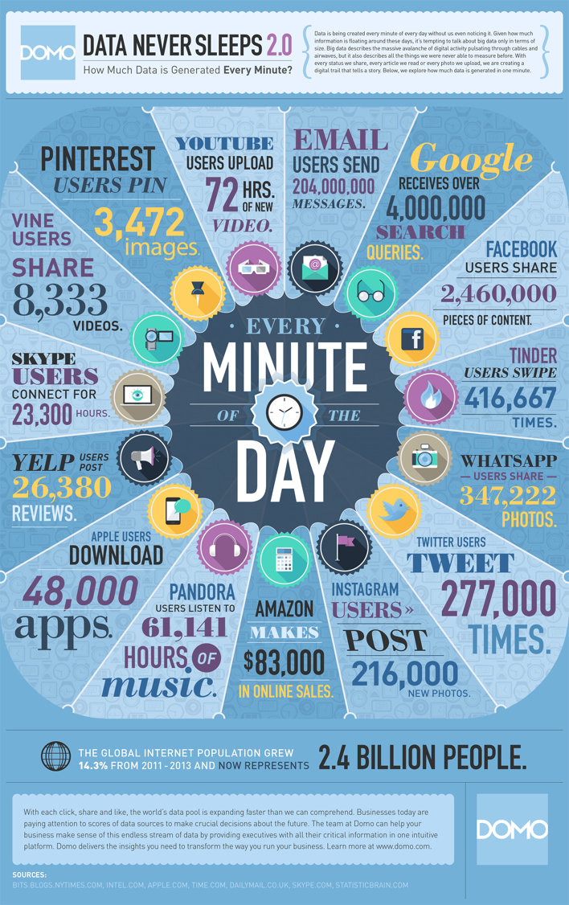
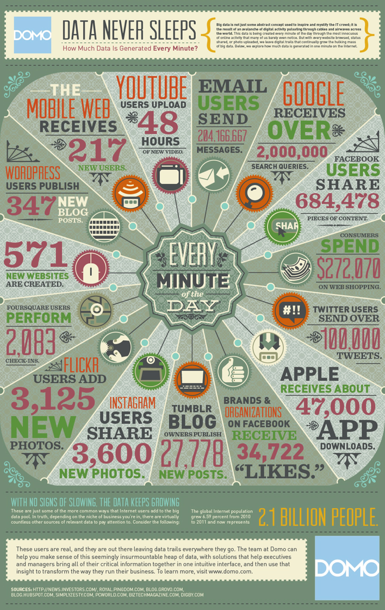
http://www.domo.com/blog/2014/04/data-never-sleeps-2-0/

Slide 8
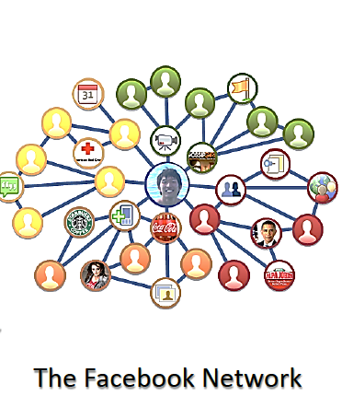
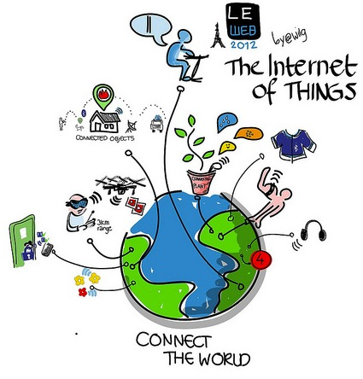
Variety:
Network Data are Heterogeneous
http://kdd2012.sigkdd.org/sites/keynote/2012-08-KDD-Keynote-Han.pdf
http://wilgengebroed.nl/leweb-2012-the-internet-of-things-a-visual-overview-in-live-ipadsketches/

Slide 9
Challenges of Analyzing Big Social Network Data
The full networks cannot be completely observed at a one glance.
Conventional operations (e.g., average path length) can take a long time, not to mention more complicated ones
Rich information embedded: parameters, structures and different semantics.
Possible Solutions to extract information effectively and efficiently
  Sampling & Summarization
Simplify the complex!

Slide 10
Sampling vs. Summarization
Sampling for Social Network
  Assume the information of a node becomes known only after it is sampled
  Goal: gradually identify a small set of representative nodes and links of a social network, usually given little prior information about this network
  Methods: random sampling, exploration-based, etc.
Summarization Social Network
  The entire social network is known in prior
  Goal: condense the social network as much as possible without losing too much information
  Methods: Aggregation, abstraction, compression, application-oriented.

Slide 11
Values of Sampling and Summarization in the Big Data Era
Allow data miners to perform advanced mining tasks in large graphs
Enable scalable storage and querying
Facilitate the development of real-world applications
化繁為簡
見微知著
執簡馭繁

Slide 12
Tutorials
“Sampling and Summarization for Social Networks”
  with S.-D. Lin and C.-T. Li
  in PAKDD 2013:
  http://mslab.csie.ntu.edu.tw/tut-pakdd13/samsum-pakdd13.pdf
  and SDM 2013:
  http://www.siam.org/meetings/sdm13/lin.pdf

Slide 13
Our related Work

Slide 14
Sampling from Heterogeneous Social Networks: What’s New?
In a homogeneous social network,
  i.e., every node and link is treated equally
studies usually focus on preserving:
  (in- and/or out-) degree distribution (Power Law),
  hop-plot (small world),
  clustering coefficient,
  etc.
E.g., J. Leskovec et al., “Sampling from large graphs,” KDD’06
All these studies do not consider the various types of nodes and links in a heterogeneous social network.

Slide 15
Sampling Type Distribution from Heterogeneous Social Networks
Li and Yeh, PAKDD 2011
Sampling
Random-based Sampling
Chain-Referral Sampling
Indirect Inference Sampling
Original Network
Samples
We consider preserving:
&
Inter-type link
count
Intra-type link
count
Node Type distribution
Inter/intra-type link proportion

Slide 16
Remarks
We compared the effect of different sampling methods on preserving link and node type distributions.
Future: devise new algorithms to preserve different properties of heterogeneous social networks.

Slide 17
Summarization for Social Networks
Parameter-wise information
  “An Efficient Approach to Updating Closeness Centrality and Average Path Length in Dynamic Networks,” with C.-C. Yen and M.-S. Chen, IEEE ICDM 2013
Semantic-wise information
  “What Distinguish one from its Peers in Social Networks?” with Y.-C. Lo, J.-Y. Li, S.-D. Lin, and J. Pei, DMKD 2013.
Structure-wise information
  In preparation for submission

Slide 18
Parameter-wise Summarization
Closeness centrality CC(v) of a node v:
  the inverse of the average shortest path distance from v to other nodes.
  measures the communication efficiency of v within a network: higher CC(v), v is easily reachable to more people.
  Example use: pick a person with high CC so that he can maximize the spread of some info.

Slide 19
CC(v) to Dynamic Changes
Frequent edge insertion/deletion in social networks
  Quick update of CC(v) in response to each edge change
Naïve solutions:
  Update all-pair shortest paths at each edge insertion/deletion
  O(n(m+n)) based on the breadth-first search (BFS) method for an undirected graph, where n and m are the number of nodes and edges in the graph.
  Too costly

Slide 20
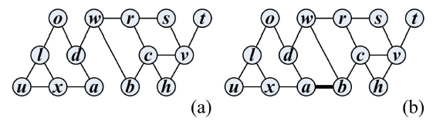
Illustration of the Problem
e(a,b) is newly inserted, so d(a,b) changes.
d(c (neighbor of b),x (neighbor of a)) changes as well.
d(u,v (both are not the neighbor of a nor b)) changes as well.
Paths of r to all other nodes do not change at all.
How can we quickly detect the affected vertex pairs (unstable vertex pair) and update their shortest distances only?

Slide 21
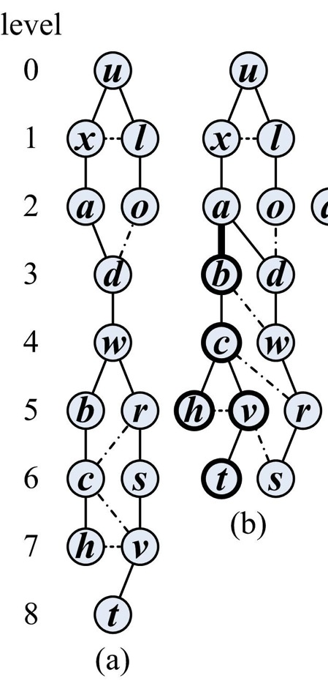
Unstable Vertex Pair to Edge Change
BFS of (a) original graph G (b) G’ = G + e(a,b) starting at node u.
We see that only paths of (u,b) , (u,c), (u,h), (u,v), and (u,t) change.
These are called unstable vertex pairs.
V’_{u}=(b,c,h,v,t): the set of nodes whose level change!

Slide 22
Main Algorithm: CENDY
After the addition of edge (a,b), we compute V’_{a} and V’_{b}.
V’_{a}
V’_{b}
Only the shortest paths between nodes from V’_{a} and V’_{b} are possibly change and need to be updated.

Slide 23
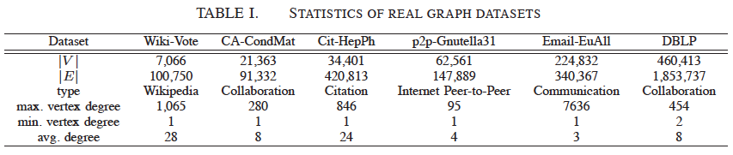
Experiments
We did experiments on 6 real-world data sets.
Only the results of edge insertion are shown here. (results of edge deletion are similar)

Slide 24
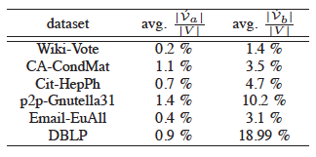
Experiments
We can see that the closeness centralities of all vertices can be updated only by a few of BFS processes.
E.g., DBLP contains 460,413 nodes. The naïve way requires to perform 460K BFS processes to update closeness centrality. However, CENDY only requires 4K BFS processes.

Slide 25
Remarks
As our first step, we devise CENDY to efficiently update the closeness centrality of each node in the social network in response to fast edge change.
CENDY can quickly capture the dynamics of the average path length of a network as well.
Future: devise new algorithms to quickly obtain more key parameters in the fast changing social network.

Slide 26
Semantic-wise Summarization
In a heterogeneous social network, what are the differences between nodes of the same type?
  For example, given a movie network containing directors, actors, movies, and so on. What makes Julia Roberts and Angelina Jolie, both are famous actresses, different?
Ego-centric abstraction: utilize the neighbor information to describe the uniqueness of an ego.

Slide 27
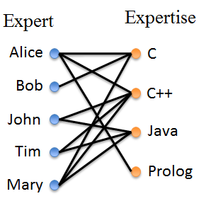
Problem definition with Example
What’s the difference between Alice and other experts?
  Alice is the only one
  masters {Prolog}.
  Other than John, Tim, and Mary,
  Alice is the only one masters C++.
  Other than Mary, Alice is the
  only one masters {C++, Java}
Working definition
  Given a node, find a unique
  identification group(UID) to
  make it unique
  UID is the combination of
  identifier set and peer set
  For 1, the UID is {Prolog}
  For 2, the UID is {C++, John, Tim, Mary}
  For 3, the UID is {C++, Java, Mary}

Slide 28
Why to Identify the Uniqueness of an Ego? Potential Applications
Social entity search engines: summarizing important information of entities
  Alice is the only one masters {Prolog}.
  Mary is the only one masters {C, C++, Java}.
Substitution recommendation systems Finding alternatives given
interests
  Other than John, Tim, Mary, Alice is the only one masters C++.

Slide 29
Unique Identification Groups(UID)
Ego is the interested entity.
UID = Identifier set + peer set
Identifier set is a subset of neighbors of the ego, represented as M
Given M, a peer set is of the same type as the ego, and is structure equivalent to the ego, represented as SE(ego, M)
M={C++}
C
SE(ego, M)
={John, Tim,
Mary}
Bob
Expert
ego
C++
John
Expertise
Alice
Java
Tim
Prolog
Mary

Slide 30
Quality of UIDs
1st priority: Smaller peer set: SE(ego, M) means ego is more unique given M
2nd priority: With the same SE size, smaller M includes less information to make ego unique
Quality: (c) > (b) > (a)
(a)
SE(ego, M)
={John, Tim,
Mary}
(c)
M
={C++}
(b)
M
={C, C++}
SE(ego, M)
={Mary}
M
={Prolog}
SE(ego, M)
=φ
C
Bob
C
Bob
C
Bob
ego
ego
ego
C++
John
C++
John
C++
John
Alice
Alice
Alice
Java
Tim
Java
Tim
Java
Tim
Prolog
Mary
Prolog
Mary
Prolog
Mary

Slide 31
Find UID－
NP-hardness and heuristic methods
Finding minimal M to guarantee minimal SE set is proven as NP-hard. (Set covering optimization problem)
Three heuristic methods
  Given ego, include all neighbors of the ego as M.
  (One-Hop+ Method)
  Given ego, include only one neighbor that introduces the least SE vertices (One Neighbor Method)
  Given ego, greedily add neighbors until SE(ego, M) is minimized. (Multi-Neighbor Method)

Slide 32
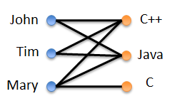
MUID: An Extension from UID
MUID(Mutual unique identification group):
  A set of nodes where each member can be uniquely identified by the subset of remaining nodes in the set. i.e., Each member has a UID.

Slide 33


Criteria to Evaluate MUID
Very similar to the criteria of UID metric
  1st consider SE size, 2nd M size
  Because every entity in MUID has its own M and SE, we take their union and compare them in order.

Slide 34
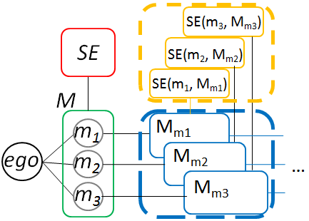
Finding MUID － Challenge
For each node that is included into the UID set (either as M or SE), we need to further uniquely identify them.
More complicated compared to finding UID.
We extend the three heuristic methods to solve this problem.
UID
of ego

Slide 35
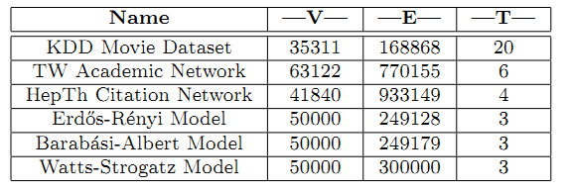
Experiments
We did the experiments on 3 synthetic and 3 real-world data set.
The results showed that the Multi-Neighbor method got better UID/MUID results in general.

Slide 36
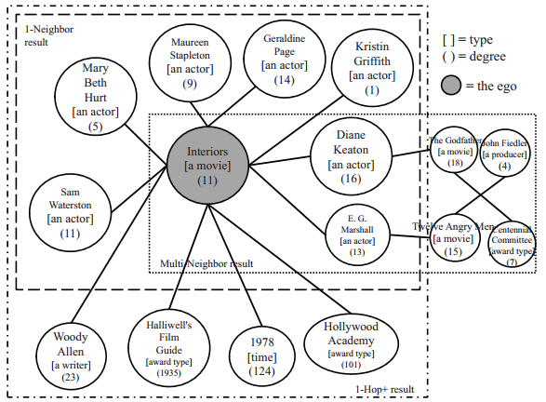
Experiment Result – Case Study

Slide 37
Remarks
We propose a new problem: using UID/MUID as an abstraction of the uniqueness of an ego.
As it is a NP-hard problem, we proposed three heuristic methods to find them.
Future work
  Investigate other metrics like diversity of types, coverage, etc.
  Efficient & Effective models to identify such sets with complexity analysis

Slide 38
Structure-wise Summarization
Generative pattern mining
  Find the basic generation units of a given heterogeneous social network.
  These generation units can be regarded as the skeleton or the principal component of the given heterogeneous social network.
  Applications:
    Enable efficient storage
    Become a new feature for similarity measurement between two given heterogeneous social networks
Social network compression
No details because they are in submission ☺

Slide 39
Conclusions
In this talk, I show our preliminary results on sampling and summarization for big complex network data.
Through summarization, we can capture the key ingredients, including the parameter-wise, structure-wise, and semantic-wise information, in the big social network.
More application-oriented sampling and summarization methods for big social networks are still needed.

Slide 40
Thank you!
Comments and Questions are welcome.

