Slide 1
ARMvisor - A KVM Based Hypervisor for ARM
鍾葉青教授
國立清華大學資訊工程學系
系統軟體實驗室

Slide 2
Outline
The Trend of Mobile Virtualization
Design and Implementation of ARMvisor
Mobile Virtualization Examples
ARM-based Server for Cloud Computing
Conclusions

Slide 3
The Trend of Mobile Virtualization

Slide 4
The Timeline of Virtualization
Para-virtualization
Traditional-virtualization
HW-assist
1972 IBM VM/370
1999 VMware
2003
Xen
2005
Intel VT
2006
AMD VT
2007
KVM-X86
1964 IBM CP-40
1997 Virtual PC
2012
Xen-ARM
KVM-ARM
Mainframe
Virtualization
Desktop
Virtualization
Server
Virtualization
Cloud
Computing
Time Sharing
Mobile
Virtualization
Virtual Memory

Slide 5
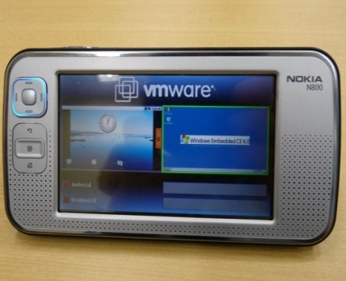
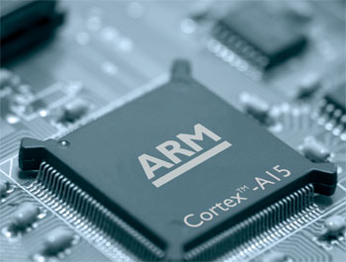
Mobile Virtualization Trend
Gartner predict that by 2012, more than 50% of new smart phones shipped will be virtualized
VMware MVP
ARM Cortex-A15 enables efficient handling of the complex software environments including full hardware virtualization

Slide 6
Use Cases
Portability
Multiple OSes on a single chip
Security
Dynamic Update of System Software
Legacy Code re-use
IP Protection
Mobile Manageability
Linux
RTOS
Linux
Security
Embedded
Hypervisor
Embedded
Hypervisor
P1
P2
P1
P2
multiple operating systems
security environment
Reference : http://en.wikipedia.org/wiki/Embedded_Hypervisor

Slide 7
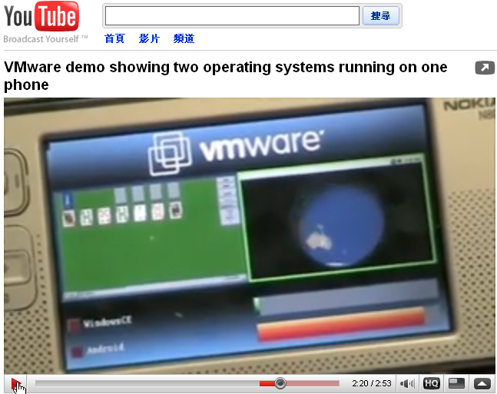
Example: VMware Demo
Windows
Mobile
Android

Slide 8
ARM Virtualization Challenges
Non-virtualizable ISA
No hardware virtualization support
Resource limitations of mobile devices

Slide 9
Challenge 1
Non-virtualizable ISA
  Virtualization theory really started with a paper from Gerald Popek and Robert Goldberg called Formal Requirements for Virtualizable Third Generation Architectures. (1974)

Slide 10
Solution of Challenge 1
Non-virtualizable ISA
  Para-virtualization
    E.g. VMware, Xen-ARM, and Virtual Open Systems
  Dynamic binary translation
    No enough memory space for code cache
    Need more powerful CPU to handle DBT
    No one use this solution so far

Slide 11
Challenge 2
No hardware virtualization support
  In x86 architecture (Intel and AMD) have provided their hardware support for virtualization several years ago.
  The maintenance of Para-virtualization is quite difficult because of frequent OS upgrade.
  Dynamic binary translation reduces run-time performance.

Slide 12
Solution of Challenge 2
No hardware virtualization support
  ARM-architecture will provide hardware virtualization support from Cortex-A15(ARMv7).
    Will show in customer market in the end of 2012.
  Furthermore, ARM will provide hardware support for I/O virtualization in ARMv8.
    Will appear on the market in 2014.

Slide 13
Challenge 3
Resource limitations of mobile devices
  Some resources need to be used to maintain virtual machine monitor.
    E.g. CPU computing power, memory size…etc.

Slide 14
Solution of Challenge 3
Resource limitations of mobile devices
  Microkernel
    Use only small amount of ROM
    Easy to maintain because of small code size
    Easy to implement hypercall
    E.g. CODEZERO, and OKL4 Microvisor

Slide 15
Design and Implementation of ARMvisor
NTHU SSLAB

Slide 16
ARMvisor Project
Project started in the middle of 2009
The Sponsor: NTHU-MTK Joint Project
Build up a new ARM Hypervisor based on KVM
There are only two ARM-based KVM Hypervisors available:
  One was made by NTHU in Taiwan
  The other was made by Columbia University

Slide 17
Goals
Design an ARM-based KVM without hardware assisted support
  CPU Virtualization
  MMU Virtualization
  I/O Virtualization
Propose a cost model for evaluation

Slide 18
ARMvisor Progress
2009
Start Project
2010
ARMvisor v0.1 Prototype
Support ARM11MPCore (v6)
Support BeagleBoard (v7)
2011
Optimizations
CPU Virtualization
MMU Virtualization
ARMvisor v0.2 Prototype
2012
Future Work
Virt-IO
Multi-core Virtualization
Hardware Virtualization

Slide 19
Overview of ARMvisor (1)
QEMU-ARM
VM 0
VM 1
I/O
Virtualization
KVM-ARM Linux
Hypervisor
CPU Virtualization
MMU
Virtualization
CPU
MMU
Timer
I/O
Interrupt
Hardware

Slide 20
Overview of ARMvisor (2)
CPU Virtualization
Methodology: Trap and Emulation
MMU
Virtualization
Methodology: Shadow Paging
I/O
Virtualization
Methodology: Userspace I/O Emulation

Slide 21
CPU Virtualization (1)
A classification of instructions of an ISA into 3 different groups:
  Privileged instructions
    Those that trap if the processor is in user mode and do not trap if it is in kernel mode
  Sensitive instructions
    Those that attempt to affect the resources in the system.
  Critical instructions
    Those are sensitive instructions but do not trap in user mode

Slide 22
CPU Virtualization (2)
Critical
Instructions
Privileged
Instructions
Sensitive
Instructions
We need to emulate sensitive instructions and
carefully handled critical instructions

Slide 23
Sensitive Instruction Emulation
Classify sensitive, privileged and critical instructions for ARM ISA
Implement an sensitive instruction emulation engine
How to handle critical instructions?
  Lightweight Para-virtualization
    Pre-Insert swi #
    Few of guest kernel codes are patched

Slide 24
Sensitive
Critical
Privileged
S | C | P | Instruction Type | Operation | Behavior | Emulation
✓ | ✓ |  | Data-processing | ADCS, ADDS, ANDS, BICS, EORS, MOVS, MVNS, ORRS, RSBS, RSCS, SBCS, SUBS | CPSR ← SPSR | Status Register Access
✓ | ✓ |  | Status register access | MRS | GPR ← CPSR/SPSR
 |  |  |  | MSR | CPSR/SPSR ← GPR
 |  |  |  | CPS | CPSR ← CPS (A|I|F|Mode)
✓ | ✓ |  | Extended | RFE | (CPSR, PC) ← MEM
 |  |  |  | SRS | MEM ← (SPSR, R14)
✓ | ✓ |  | Load and Store Multiple | LDM(3) | CPSR ← SPSR
 |  |  |  | LDM(2) | USR_REGS ← MEM | Bank Register Access
 |  |  |  | STM(2) | MEM ← USR_REGS
✓ | ✓ |  | Load and Store | LDRT/LDRBT | GPR ← MEM (User Permission) | User Permission Access
 |  |  |  | STRT/STRBT | MEM ← GPR (User Permission)
✓ |  | ✓ | Coprocessor | CDP/CDP2, LDC/LDC2, MCR/MCR2, MCRR/MRRC2, MRC/MRC2, MRRC/MRRC2, STC/STC2 | Call CORP COPR ← MEM/GPR MEM/GPR ← CORP | Coprocessor Access

Slide 25
Patched Souse Code | LOC | Emulation
arch/arm/boot/compressed/head.S arch/arm/include/asm/assembler.h arch/arm/include/asm/irqflags.h arch/arm/include/asm/kvm-asm.h arch/arm/include/asm/kvmguest.h arch/arm/kernel/asm-offsets.c arch/arm/kernel/entry-armv.S arch/arm/kernel/entry-common.S arch/arm/kernel/head.S arch/arm/kernel/setup.c arch/arm/kernel/traps.c arch/arm/mm/abort-ev6.S arch/arm/mm/proc-macros.S arch/arm/mm/proc-v6.S | 6 71 99 154 20 12 74 20 4 6 14 5 4 6 | Status Register Access Bank Register Access Coprocessor Access
arch/arm/include/asm/futex.h arch/arm/include/asm/uaccess.h arch/arm/lib/clear_user.S arch/arm/lib/copy_from_user.S arch/arm/lib/copy_to_user.S arch/arm/lib/csumpartialcopyuser.S arch/arm/lib/getuser.S arch/arm/lib/putuser.S arch/arm/lib/strnlen_user.S arch/arm/lib/uaccess.S arch/arm/nwfpe/entry.S | 3 6 8 1 1 10 4 8 1 11 1 | User Permission Access
Total | 549
Patched Guest Kernel Codes

Slide 26
Optimizations for
CPU Virtualization
Dynamic View
  Which sensitive instructions are frequently used by the guest OS in the arm architectures?
  What activities are these frequently-used sensitive instructions used in?
Optimizations
  Reduce instruction emulation overhead / traps
    Shadow register file
    Sensitive instruction grouping
    TLB/Cache trap overhead reduction

Slide 27
Shadow Register File Optimization (1)
Hypervisor
Guest
VCPU
Register
File
Guest
Sensitive
Instructions
Trap
Sensitive Instruction
Emulation Engine

Slide 28
Shadow Register File Optimization (2)
Hypervisor
Guest
VCPU
Register
File
Sync
Shadow
Register
File
Guest
Sensitive
Instructions
Sensitive Instruction
Emulation Engine

Slide 29
Sensitive Instruction
Grouping Optimization (1)
Guest Kernel uses the vector_stub to handle interrupt/trap
Many sensitive instructions are used in the small code segment
.macro vector_stub, name, mode, correction=0
  stmia sp, {r0, lr}
  mrs lr, spsr
  str lr, [sp, #8]
  mrs r0, cpsr
  eor r0, r0, #(\mode ^ SVC_MODE | PSR_ISETSTATE)
  msr spsr_cxsf, r0
  and lr, lr, #0x0f
  mov r0, sp
  movs pc, lr
Sensitive Instructions

Slide 30
Sensitive Instruction
Grouping Optimization (2)
Grouping the small code segment by one hypercall
.macro vector_stub, name, mode, correction=0
  hypercall(vector_stub)

Slide 31
    TLB/Cache trap
    Optimization (1)
Originally, the instruction emulation path is too long!
Hypervisor
Guest
Enter System Mode
TLB and Cache
Instructions
Assembly
Code
Trap
Context Switch
Handler
Dispatcher
C
Sensitive Instruction
Emulation Engine
TLB/Cache Instruction Emulation

Slide 32
    TLB/Cache trap
    Optimization (2)
After optimization, the overhead of TLB/Cache trap is reduced
Hypervisor
Guest
Enter System Mode
TLB and Cache
Instructions
Assembly
Code
Trap
Fast Emulation
Engine

Slide 33
CPU Optimization
Base
  Trap all sensitive instructions
VCPU v0.1 Model
  R Sharing: guest directly READ virtual registers
VCPU v1.0 Model
  R/W Sharing: guest directly R/W virtual registers
  Sensitive instruction grouping
  TLB/Cache trap overhead reduction

Slide 34
Sensitive Instr. Trap Reduction
 | base version | CPU_OPT_V0.1 | CPU_OPT_V1.0
Guest sum_exits | 15536 | 8567 | 3788
Guest light_exits | 15318 | 8396 | 3555
Guest heavy_exits | 218 | 171 | 233
sensitive inst exits | 12679 | 5855 | 658
mls | 355 | 356 | 359
msr | 1567 | 1529 | 42
mrs | 1606 | 298 | 0
cps | 1842 | 1484 | 6
data | 317 | 318 | 167
copr | 6990 | 1868 | 84
ls | 286 | 171 | 402
LS (T or PT write) | 68 | 0 | 169
MMIO | 218 | 171 | 233
Total Instr Emulation | 12965 | 6026 | 1060
75.62%
76.79%
94.81%
100%
99.67%
98.80%

Slide 35
MMU Virtualization (1)
Overview
Guest
vCPU
GVA
vMMU
GPA
MMU
Virtualization
Guest Physical Memory
HPA
Host Physical Memory

Slide 36
MMU Virtualization (2)
Dynamic physical memory allocation to guest
Software MMU Virtualization
  Simulate a real ARMv6 MMU
  Build up Shadow page table
  Synchronization between Guest page table and Shadow page table

Slide 37
Dynamic Physical Memory Allocation to Guest
Host
Virtual
Memory
Guest
Physical
Memory
Host
Physical
Memory
Guest physical memory pages are allocated dynamically at runtime.

Slide 38
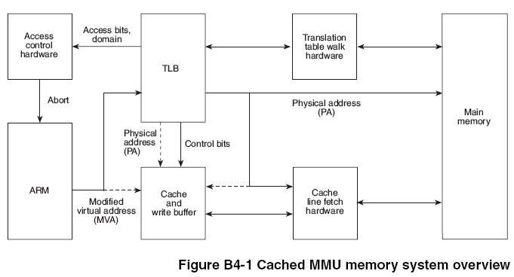
Software MMU Virtualization (1)
MMU Virtualization will behave as a real MMU chip to build up page table.
2
1
Page Table
3
Real MMU Chip

Slide 39
Software MMU Virtualization (2)
Software MMU Virtualization Processes
PABT / DABT
Trap
Real MMU Behavior
Shadow Table Behavior
1
2
3
Initial
Synchronization
Guest
Page Table
Walker
Guest
Permission
Checker
MMIO
Access
Checker
Shadow Page Table
Mapping
Shadow Page Table
Update
True permission fault
Hidden translation fault
True translation fault
MMIO emulation

Slide 40
Step 1
While page fault is ocurred, Guest Page Table Walker will walk through guest page table to check if the fault is from guest.
PABT / DABT
Trap
1
Guest
Page Table
Walker
Guest
Permission
Checker
MMIO
Access
Checker
Shadow Page Table
Mapping
Shadow Page Table
Update
True permission fault
Hidden translation fault
True translation fault
MMIO emulation

Slide 41
Step 2
The step2 will check if guest access permission is not allowed.
PABT / DABT
Trap
2
Guest
Page Table
Walker
Guest
Permission
Checker
MMIO
Access
Checker
Shadow Page Table
Mapping
Shadow Page Table
Update
True permission fault
Hidden translation fault
True translation fault
MMIO emulation

Slide 42
Step 3
Step 3 will check if the guest physical memory address used to is located in the range of MMIO address.
PABT / DABT
Trap
3
Guest
Page Table
Walker
Guest
Permission
Checker
MMIO
Access
Checker
Shadow Page Table
Mapping
Shadow Page Table
Update
True permission fault
Hidden translation fault
True translation fault
MMIO emulation

Slide 43
Steps 4 & 5
Step 4 and step 5 are used to build up shadow page tables and maintain their consistency between guest and shadow ones.
PABT / DABT
Trap
4
5
Guest
Page Table
Walker
Guest
Permission
Checker
MMIO
Access
Checker
Shadow Page Table
Mapping
Shadow Page Table
Update
True permission fault
Hidden translation fault
True translation fault
MMIO emulation

Slide 44
Build up Shadow page table
Shadow page table creation and synchronization
Guest Paging
Guest
Page
Guest
TTBR
Shadow Paging
Synchronization
Host
Page
Shadow
TTBR

Slide 45
MMU Virtualization
Optimization
Guest kernel space mapping sharing
Reduce guest page table synchronization overhead

Slide 46
Guest kernel space mapping sharing
Kernel space
Kernel space
User space
User space
Guest Process 1
Guest Process 2
Shadow table
Kernel space
Shadow table
The shadow tables of kernel space
are shared by all guest processes
User space
Shadow table

Slide 47
Reduce guest page table synchronization overhead
We use para-virtualization to inform hypervisor when guest would like to change guest page table
This method will eliminate from using write-protection for synchronization

Slide 48
I/O Virtualization
Currently, ARM I/O Emulations are supported by QEMU-ARM

Slide 49
I/O Virtualization Flow
Interrupt
Storage
Timer
UART
Network
QEMU-ARM
Guest OS
User Space
I/O Result
R/W MMIO
I/O Response
I/O Request
Trap
Kernel Space
KVM-ARM
I/O Access
ARM Architecture

Slide 50
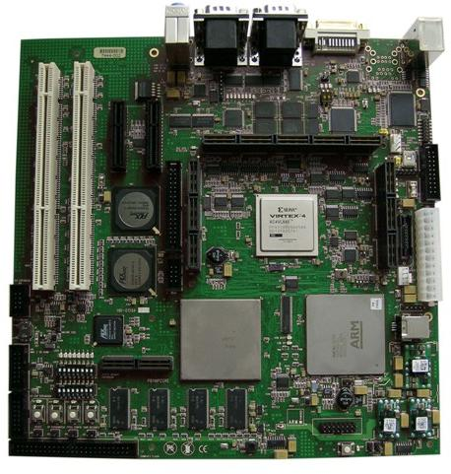
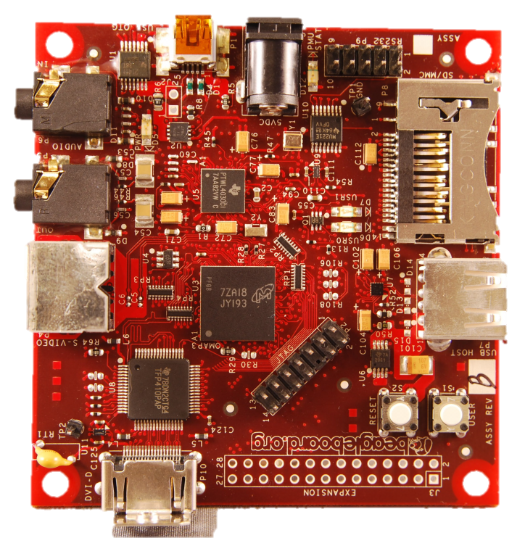


Support ARMv6 & ARMv7 architecture
ARM v6 11mpcore
ARM v7 cortex-a8

Slide 51
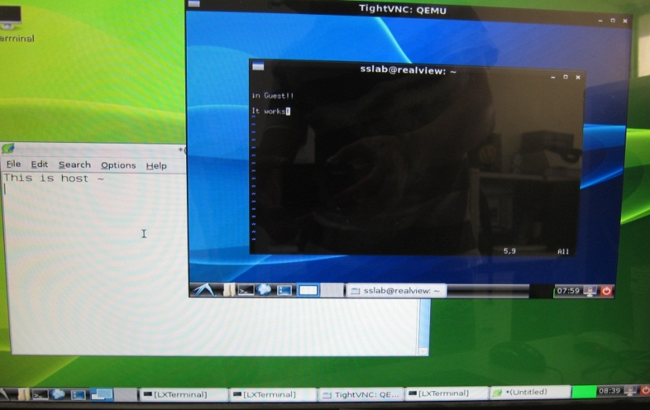
ARM Ubuntu Guest
QEMU-ARM
I/O
Virtualization
KVM-ARM Linux
Hypervisor
Interrupt
Virtualization
CPU Virtualization
MMU
Virtualization
CPU
MMU
Timer
I/O
Interrupt
Hardware

Slide 52
Performance : optimization
Average 4.65 times faster after optimization

Slide 53
Performance : Mibench
Running user-space program:
83% native performance

Slide 54
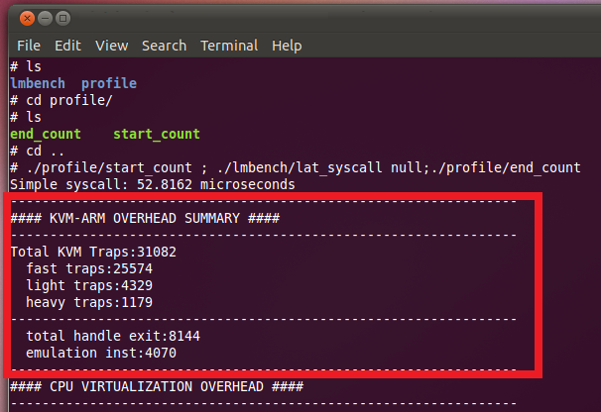
Support Profiling model

Slide 55
Mobile Virtualization Example

Slide 56
HP Calxeda (Nov.1)
ARM V8 Introduction(Oct.25)
Marvell ARMADA XP(Nov)
ARMv8
ARM HW Virtualization Announced (Sep.)
ARM HW
Virtualization
OKL4 Microvisor(Aug.)
Columbia KVM-ARM Start
CODEZERO Project Start (Jun.)
XEN-ARM Announced (Nov.)
ARMv7 Cortex-A
2004
2007
2008
2009
2010
2011
2012
2014
SSLAB ARMvisor

Slide 57

XEN-ARM
Xen-arm
  contributed by Samsung
  Now support ARM9, ARM11, ARM Cortex-A9 MP
Tend to support Xen-arm-cortext-a15
Type 1 hypervisor with para-virtualization
Notes:
contributed by Citrix
https://lkml.org/lkml/2011/11/29/265
ARM Cortex-A15

Slide 58

B LABS
CODEZERO embedded hypervisor
supports ARMv7 chipsets, virtualizes Android and Linux-based operating systems (such as Linaro and Ubuntu).
Aims to carry L4 microkernel architecture to the next level through the support of its open community.

Slide 59
B LABS CODEZERO
Only the most fundamental and abstract software mechanisms are incorporated into the microkernel.
  The microkernel becomes simple, abstract, and flexible.
Keeping the microkernel rigorously small makes the system secure and stable.
Ubuntu (Linaro-11.12) on ARM is virtualized on the CODEZERO.
http://b-labs.com/

Slide 60

Virtual Open Systems
A company operating in embedded Linux, Android, SMP Virtualization and Cloud Computing.
KVM kernel for ARM Cortex-A15 architecture is released.
Cells: a virtual mobile smartphone architecture
  SOSP '11 Proceedings of the Twenty-Third ACM Symposium on Operating Systems Principles

Slide 61

Open Kernel Labs (OK Labs)
OKL4 Microvisor
  Microkernel-based embedded hypervisor
  Designed for mobile virtualization
Secure HyperCell
  Special secure technology
  Each secure cell in the system offers isolation from software in other cells by establishing dedicated virtual address space for use only by software within the cell.

Slide 62
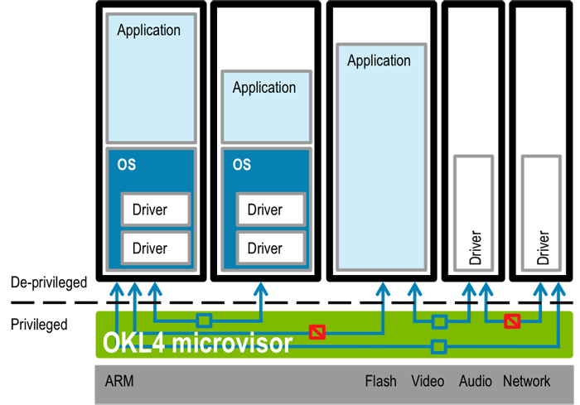
OKL4 Microvisors

Slide 63
ARM-based Server

Slide 64
The Advantages of ARM Server
1. Its size is quite small
2. Energy-efficiency
3. Highly-customized SoC for server

Slide 65
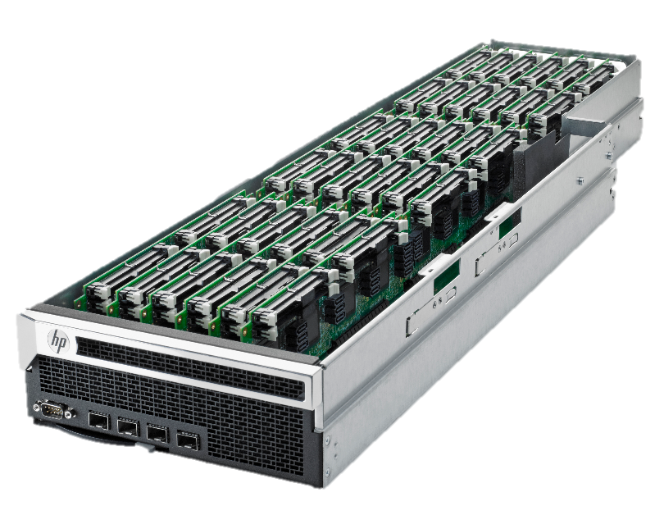
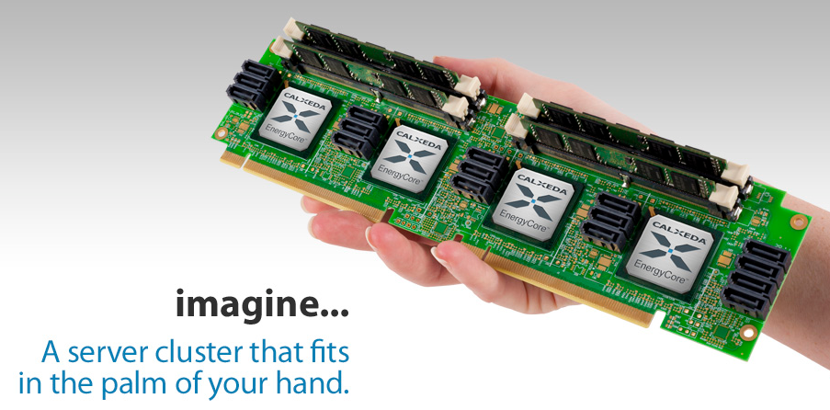
HP Project Moonshot
Only 5W per CPU

Slide 66
Advantage of ARM Server (1)
1. Its size is quite small
  In the past, some people tried to use Intel Atom to build cluster system.
  (Ref: http://tinyurl.com/6cxb4cs )
  Now, HP has announced the “Project Moonshot” which can plug 2800 SoC cards which contains dual-core ARM processor at the same time.
  (Ref: http://tinyurl.com/3oba5ax )

Slide 67
Advantage of ARM Server (2)
2. Energy-efficiency
  Energy-efficiency also become more and more important in server-side. As a result, ARM-based server can use its advantage on energy-management.

Slide 68
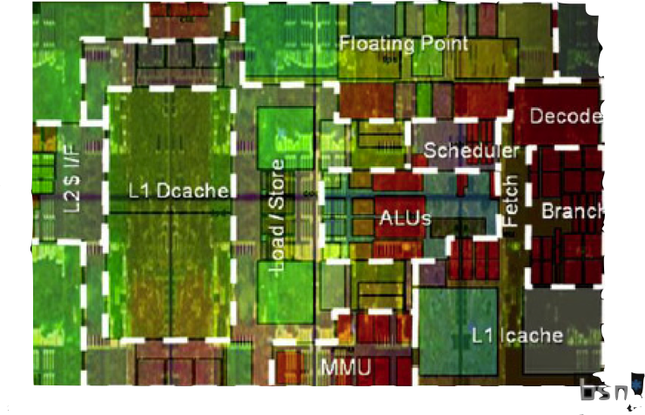
Advantage of ARM Server (3)
3. Highly-customized SoC for server
  SoC design house can provided fully-customized SoC for customer. And this is what Intel and AMD cannot do.
NVIDIA Project
Denver

Slide 69
ARM Server Challenges
1. No 64-bit support
2. Poor performance than x86

Slide 70
ARM Server Challenges 1
No 64-bit support
  ARM does not support for 64-bit until ARMv7
  It means that its size of memory cannot be more than 4GB.
  (Although ARMv7 use 40-bit address technology to extend it into 1TB)
  Its accuracy in float point is less than x86.

Slide 71
Solution of Challenge 1
No 64-bit support
  However, ARM-architecture will support 64-bit after ARMv8 which will provide in consumer market in 2014

Slide 72
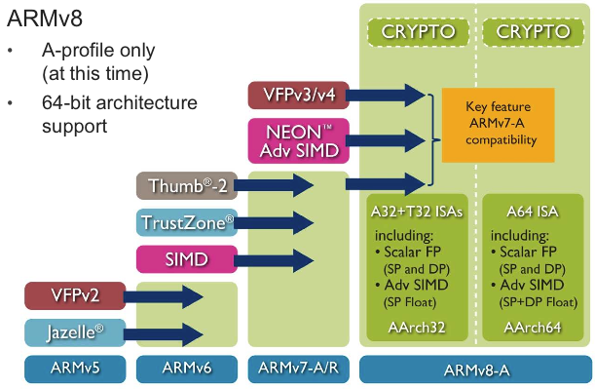
ARMv8 Features

Slide 73
ARM Server Challenge 2
Poor performance
  In server-level computation, ARM-based computer was less powerful than x86-based computer.
  ARM-based processor clock-rate is less than 2GHz in a core. Meanwhile x86-based processor clock-rate can reach 4GHz in a core.
  Besides, we can only put at most 4 cores on one chip in ARM-based computer. Meanwhile we can put more than 32-cores on one chip in x86-based computer.

Slide 74
Solution 2
Poor performance
  We can put 128 cores on chip in the spec of ARMv8
  Its clock-rate can reach 3GHz.

Slide 75
Intel Server vs. ARM server
Machine | ARM server TODAY HP Energy-core ECX-1000 | ARMv8 | Modern x86 Blade server HP ProLiant BL460c G6
Volume | Smaller | No data | Larger
Clock-rate | 1.4 GHz | 3GHz (in spec) | 2.13 GHz
Max number of cores or processor | 4 processors | 128 cores (in spec) | 6 cores
Energy-efficiency | 5W in full-speed 2.5W in idle | No data | 80 W
Memory | Max to 16 GB | No data | Standard 6GB Max to 384 GB
H/W for virtualization | No | Yes | Yes
Notes:
HP Energy-core ECX-1000
HP ProLiant BL460c G6

Slide 76
Conclusions
Mobile device is getting powerful and virtualizable.
System virtualization for ARM is useful for mobile device and future ARM based server
The future works of ARMvisor
  Support Multi-core Virtualization
  Support Hardware Virtualization
  Optimize I/O Virtualization

