Slide 1

Large-Scale Financial Risk Management Services
Jan-Ming Ho
Research Fellow
Notes:
Good Afternoon, committee members and colleagues. I am going to present the ongoing research of the financial computation group of our laboratory.

Slide 2
Background
Worldwide credit crisis and the credit rating agencies
  Enron’s bankruptcy in 2001
  Lehman Brother’s in 2008
    Synthetic CDO backed by RMBS and CDS
The Credit Rating Business
  Protected Oligopoly
    SEC designation of NRSROs
    Nationally Recognized Statistical Rating Organizations
  Issuer-pays business model and Conflict of interest
  Long-term perspective vs up-to-minute assessment
Recommendations (e.g., Lawrence J. White, 2010)
  Allowing Wider Choices
  Bond manager’s choice of reliable advisors
  Prudential oversight of regulators
Notes:
During and after the worldwide credit crisis, people start to complain the government and the credit agencies for not doing a good job to guarantee a safe financial environment.
The bond manager are supposed to have efficient complication in making choices of reliable advisors, i.e., either internal research unit or external advisors. The regulators takes the responsibility of oversee the financial institutions on their procedures of choosing advisors
Internal Research, External Advisor, Credit Default Swap Market

Slide 3
Taking the Opportunity
Corporate Credit Rating
Computing Risk Measure
Real-time Derivative Valuation Service
Benchmarking Trading Algorithms
Notes:
I’ll present our strategies of taking the opportunity in this presentation. I’ll skip the last sections in case of running out of time. For these skipped sections, please look into the slides if you are interested.

Slide 4
Corporate Credit Rating
Notes:
I’ll present our strategies of taking the opportunity in this presentation. I’ll skip the last sections in case of running out of time. For these skipped sections, please look into the slides if you are interested.

Slide 5
Corporate Credit Rating
  Credit Rating
    Rating agencies such as Moody's Investors Services and Standard & Poor's (S&P)
    21 and 22 classes for long term rating
Our method
  Using Duffie’s model to estimate default probability
  Optimal partition of default probabilities into classes
Notes:
Each company is associated with a discrete number, say 1 to 9, instead of a real-valued default probability.

Slide 6
Duffie’s Model of Default Probability
Default event
  A Poisson process with conditionally deterministic time-varying intensity
Default intensity of bankruptcy and other-exit
  Function of stochastic covariates
  Firm-specific and macroeconomic
Maximum Likelihood Estimation
  Default probability of a firm in the next quarter

Slide 7
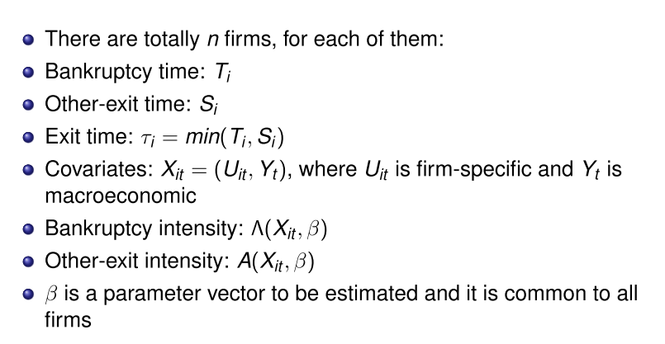
Notations

Slide 8
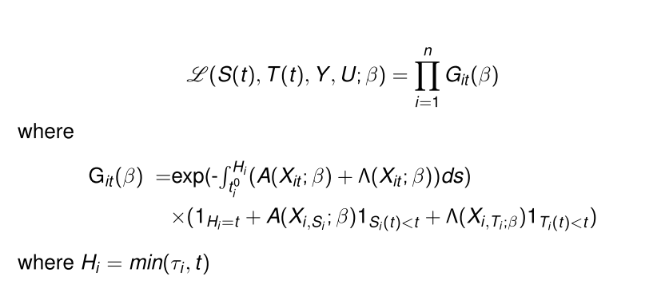
Likelihood Function

Slide 9
Power curve
Cumulative accuracy profile (CAP)
Sorting the in-sample conditional default probabilities in non-increasing order
Percentage of accumulated defaulted firms in the next quarter

Slide 10
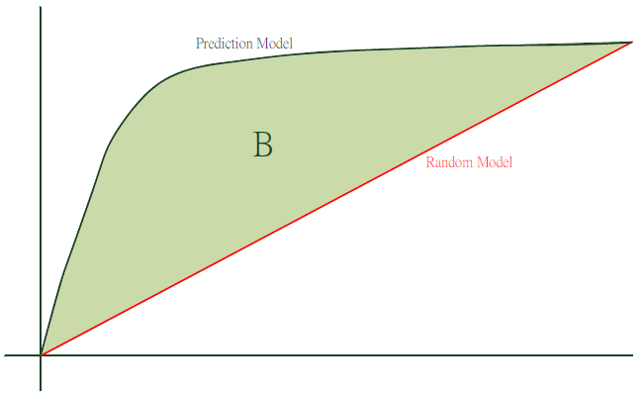
Power Curve
%companies defaulted
In the next quarter
Perfect Model
A
accuracy ratio (AR) = B/A

Slide 11
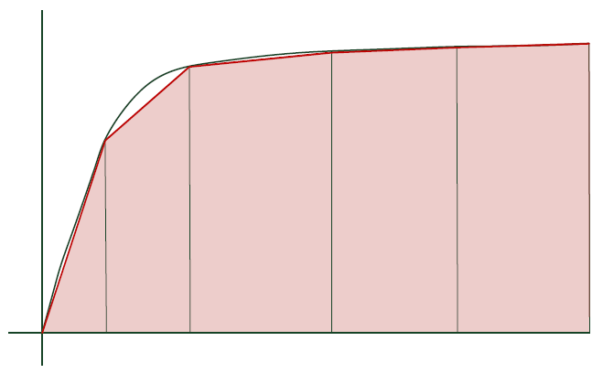
Optimal Quantization of Power Curve (OQPC)

Slide 12


The Problem OQPC
Given a monotonically non-decreasing array of numbers f[0:n]
Find k cuts {c_{i}|1 ≤ i ≤ k, c_{i} ∈ [0, n], 0 < c₁ < c₂ < ... < c_{k} < n}.
Such that The area enclosed by the array C={0,c₁,c₂,..., c_{k}, n} is maximized

Slide 13
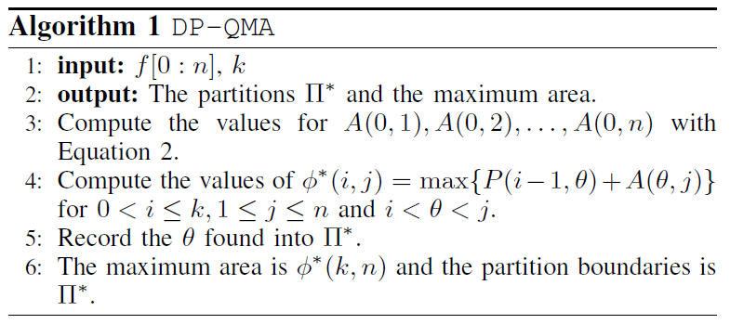
Dynamic Programming
The algorithm for DP-QMA runs in O(kn^2) time.

Slide 14
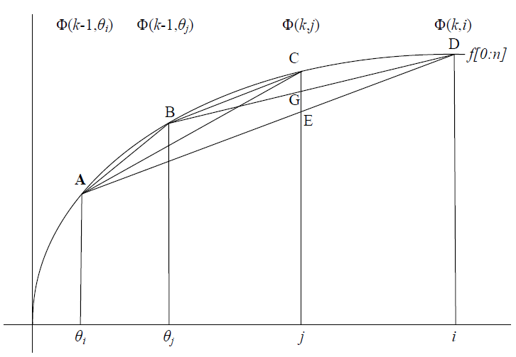
Mononiticity of Tail Areas
θ(k, i) is monotonic increasing in i, i.e., If i ≥ j, then θ(k, i) ≥ θ(k, j).

Slide 15
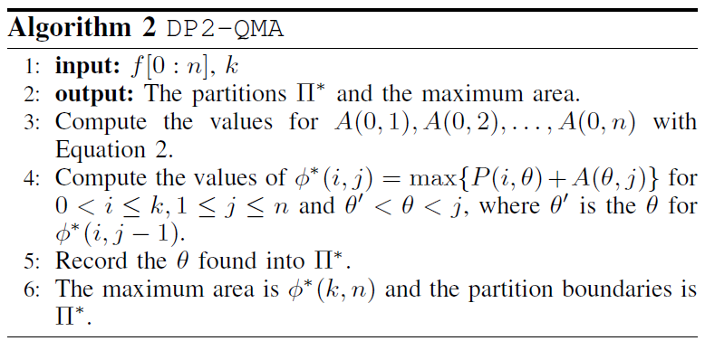
Improved Dynamic Programming
The algorithm DP2-QMA runs in O(kn^2) time.

Slide 16
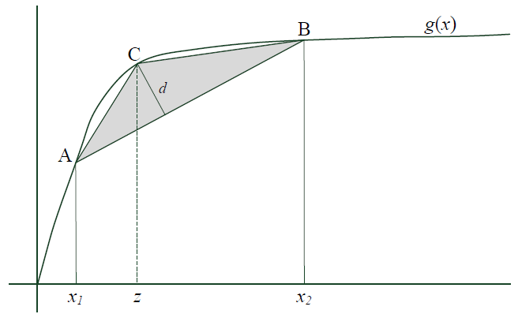
Optimal Cuts of Continuous Power Curve
If x₁, z, x₂ are 3 consecutive cuts and z is an optimal cut between the cuts x1 and x2, then the f′(z) must be equal to the slope of AB.

Slide 17
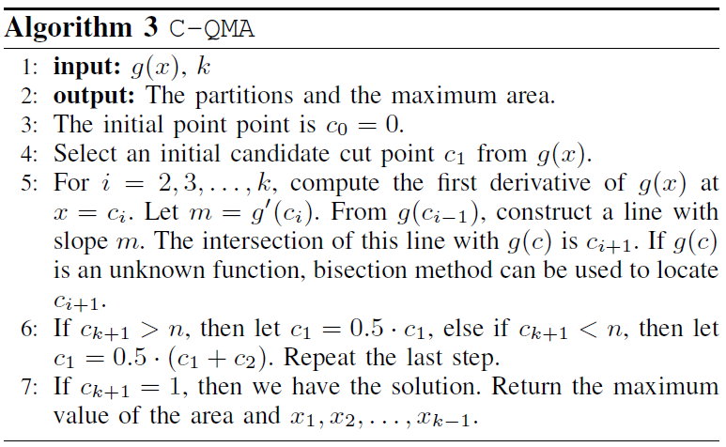
Continuous Algorithm
This algorithm runs in O(k log^2 n) time.

Slide 18
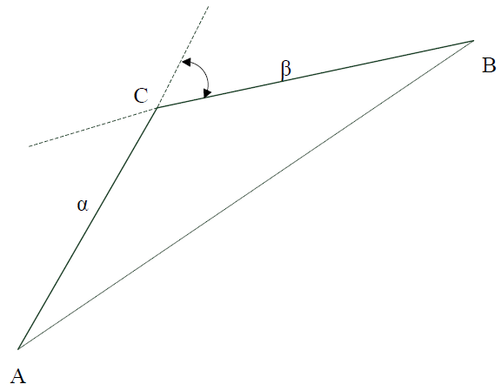
Enclosing Slopes
The enclosing slopes of the point C is the slope of the segment AC and the slope of the segment BC.

Slide 19
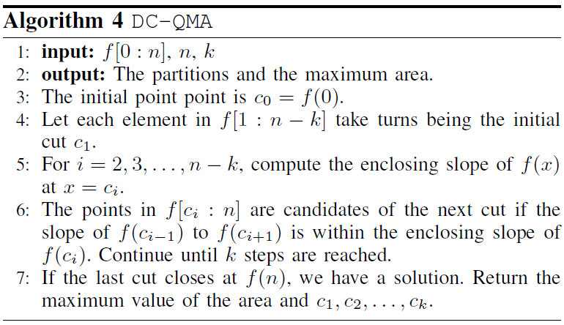
Enclosing Slopes Algorithm
Algorithm DC-QMA runs in O(k nlog n) time.

Slide 20
Linear Time Heuristic
We observed that:
  Φ⁺(k, n) is a convex function of n, Θ⁺(k, n) is monotonic in n, and Θ⁺(k, i) ≥ Θ⁺(k, j) if i > j.
If the above claim is true, then we have an O(k n) time algorithm.

Slide 21
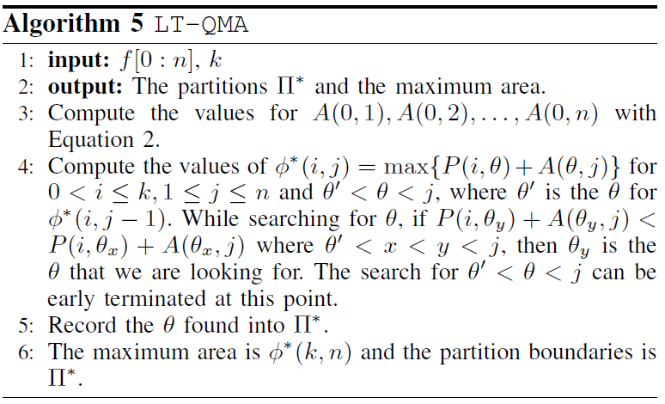
A Linear Time Heuristic

Slide 22

Numerical Experiment
Points sampled from the function
Computer environment:
  Pentium Xeon E5630 2.53G with 70G memory.
  GCC v4.6.1
  Linux OS.

Slide 23
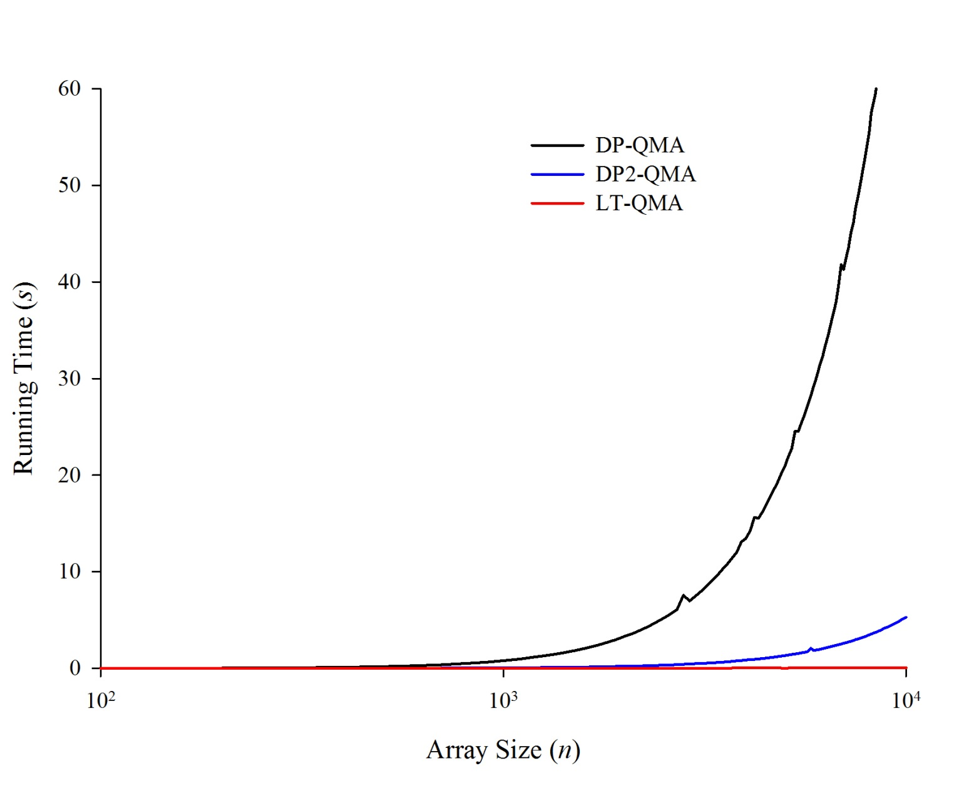
Running Time – Fixed k

Slide 24
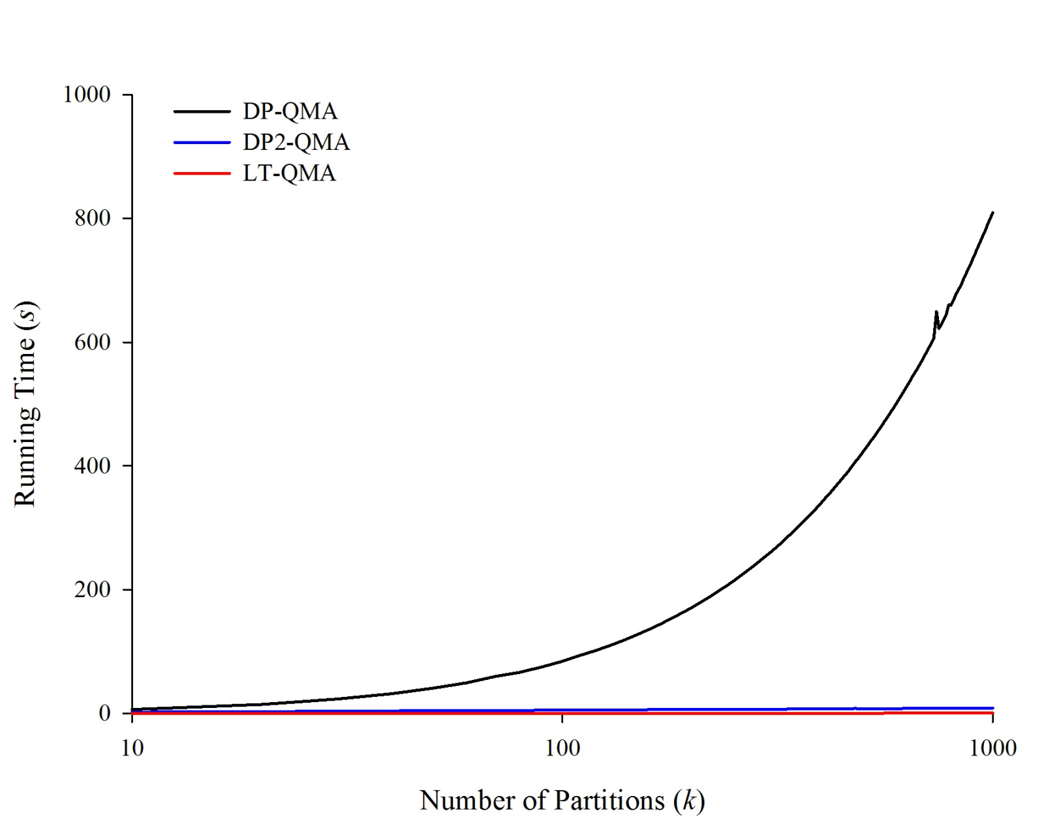
Running Time – Fixed n

Slide 25
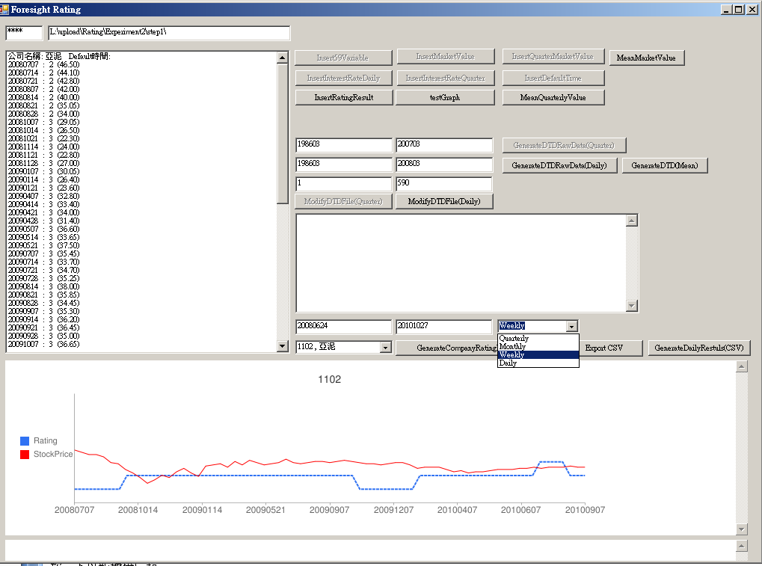
Asia Cement

Slide 26
Real-time Credit Rating
Early warning of companies getting close to default
  Using real-time market data
  Testing effectiveness and efficiency of subsets of variables
Notes:
Using market data to enhance responsiveness of credit rating

Slide 27
Computing Risk Measure

Slide 28
Value at Risk (VaR)
Early VaR involved along two parallel lines:
  portfolio theory
  capital adequacy computations
Hardy (1923) and Hicks (1935) ~ non-mathematical discussion of portfolios
Leavens (1945) ~ a quantitative example
  may be the first VaR measure ever published.
Markowitz (1952) and Roy (1952) ~ a means of selecting portfolios
  optimize reward for a given level of risk.
Dusak (1972) ~ simple VaR measures for futures portfolios
Lietaer (1971)~ a practical VaR measure for foreign exchange risk.
  integrated a VaR measure with a variance of market value VaR metric
Notes:
Now, let’s take a brief look at the history of Value at Risk. The concept of Var evolved along two parallel lines, portfolio theory and capital adequacy computations. Hardy and Hicks were the first researchers to present a non-mathematical discussion of portfolios. Then a few decades later, Leavens provided a quantitative example of a VAR measure. Markowitz and Roy later developed a means of selecting portfolios and optimize reward for a given level of risk. Dusak proposed a simple VaR measure for futures portfolios, and Lietaer did the same for foreign exchange risk

Slide 29
J.P. Morgan (1994)
  Published the extensive development of risk measurement, VaR
  gave free access to estimates of the necessary underlying parameters
U.S. Securities and Exchange Commission (1997)
  Major banks and dealers started to implement the rule that they must disclose quantitative information about their derivatives activities by including VaR information.
Notes:
In 1994, JP morgan published the method and gave free access to estimates of the necessary underlying parameters. And in 1997, due to the regulation of US securities and exchange commission, major banks and dealers started to implement the rule that they must include VaR information.

Slide 30
Tail conditional expectation (TCE)
The tail conditional expectation (TCE) is one of several coherent risk measures
  P. Artzner, F. Delbaen, J.-M. Eber, and D. Heath, “Coherent measures of risk,” Mathematical Finance, vol. 9, no. 3, pp. 203-228, 1999
Notes:
Now I want to introduce Tail conditional expectation (TCE). TCE proposed by Artzner et al. is one of several coherent risk measures.

Slide 31
Definition of Tail Conditional Expectations
Value at Risk (VaR):
Notes:
We are all familiar with Value at Risk (VaR). In this figure, the X-axis represents the portfolio gain and the Y-axis represents the probability. Here VaR10% means the value of the portfolio gain in the worst case scenario, where the area of probability of the left tail sums to 10%.
The equation is the definition of TCE. In this paper, we focus on the computation of the TCE value of portfolios.

Slide 32
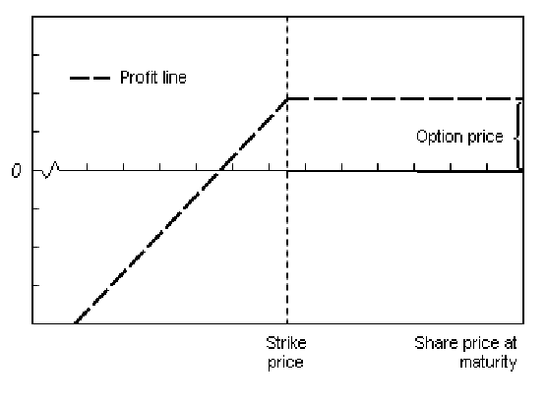
Value of a Sell Put

Slide 33
Margin Requirement
Chicago Board, Options Exchange, CBOE
66% of the margin as collateral

Slide 34
Modeling Stock Price
Lognormal Distribution
  Black –Scholes
Multiplicative Binomial Distribution

Slide 35
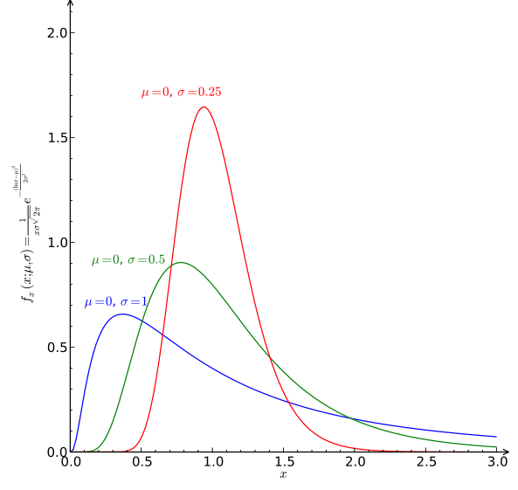
Log-Normal Distribution

Slide 36
Binomial model
Where:
The probability of up is:
Here σ is the volatility of the underling stock price and t = one time step / time period of σ
Notes:
This is the binomial model, which we are all familiar with.
We use it to obtain the distribution of the underlying stock price from time zero to maturity time.

Slide 37

Expected Value of a Put

Slide 38
The Problems
To speed up the computation of the TCE of a portfolio gain at time T
We study two cases :
  Single stock and single option (SSSO) in a portfolio
  Single stock and multiple options (SSMO) in a portfolio
Notes:
Our purpose is to speed up the computation of the TCE of a portfolio gain at a specific time T in the future. To this end, we present algorithms to handle two cases: in the first case, SSSO, the portfolio only contains one stock and one option. We call it the SSSO case. The second portfolio, SSMO, contains a single stock and multiple options.
Due to the time limitation, I will only consider the first case. For further details, please refer to our paper, or contact the authors.

Slide 39
Starting Point
We start by computing the TCE of selling a put option
  Given a put option starting at time t=0 and strike at maturity time t=U with a strike price K
  At time t=0, we want to predict the TCE at time t=T
Notes:
We start by computing the TCE of selling a put option, Given a put option starting at time zero and strike at maturity time U with a strike price K, we want to predict the TCE at time T.

Slide 40
Model
Given a model of the future price of a stock at time t, where 0≦t≦U
  F_{S}(T) = distribution of stock price S at time T
  F_{R} (T,U) = distribution of price ratio R at time U with respect to time T, where R = F_{S}(U)/F_{S}(T)
Note that F_{S} and F_{R} can be computed empirically or theoretically.
Notes:
Now, I’d like to present a model of the future price of a stock at time t, where t is between 0 and U . We can obtain two distributions: the distribution of stock price S at time T, and the distribution of the price ratio R at time U with respect to time T. We use these two distributions to derive our algorithms. Note that these two distributions can be computed either empirically or theoretically.
Without loss of generality, we use Fs to denote distribution of stock price S at time T, and Fr to denote the second term

Slide 41
The SSSO Case
Notes:
Let’s look at the calculation method used for the SSSO case

Slide 42
The SSSO-Naive Algorithm
If K ≧ S_{i}*R_{j}, the portfolio gain (v) equals
If K < S_{i}*R_{j}, the portfolio gain (v) equals
The portfolio gain at time T can be computed as follows:
where P₀ is the initial option price; i=1,…,m; and j=1,…,n
Under the binomial model, selling a put option, V_{i} is strictly decreased when i is increased
  We can determine the position of the p-quantile among the nodes at time T before calculating the portfolio gain.
Notes:
This is the SSSO-naive Algorithm we use to compute TCE. There are two methods for calculating the portfolio gain v under different conditions. In maturity, if the underlying stock price is lower than the strike price, we use the top equation; otherwise, we use the bottom equation. In this case, we calculate all the points in maturity, Then we can obtain the distribution for the portfolio gain at time T. We can find the position of the p-quantile among the nodes at time T before calculating the portfolio gain because all the Vi values calculated by the binomial model have monotonic characteristics. After obtaining the distribution of Vi at time T, we can compute the TCE.

Slide 43
Steps of the SSSO-Naive Algorithm
r₁ = u^{m}
S₁ = stock_price * r₁
The computational complexity of the SSSO-Naive Algorithm is O(m*n)
S₁
S₂
……………
u^{n}
u^{n-1}d
u^{n}
u^{n-2}d²
u^{n-1}d
u^{n}
p-quantile
S_{m-3}
…….
u^{n-2}d²
…….
u^{n-1}d
S_{m-2}
…….
u^{n}
u^{n-2}d²
u^{n-1}d
…….
d^{n}
S_{m-1}
…….
u^{n-2}d²
…….
d^{n}
S_{m}
…….
…….
d^{n}
d^{n}
Notes:
Here are the steps for calculating TCE in the SSSO-Naive Algorithm. First, we use the binomial model to obtain the distribution of the underlying stock price at time T, Then we can determine the position of the p-qauntile. We use the equation introduced earlier for calculating the portfolio gain to calculate each point once, which yields the TCEp value. The computational complexity of the SSSO-Naive Algorithm is O(m*n)

Slide 44
The SSSO Algorithm
There are two inequalities from/in? the binomial model:
S₁ ≥ S₂ ≥ …≥S_{m} and R₁ ≥ R₂ ≥… ≥ R_{n}
  The derived strike price ratio K/S_{i} is a monotonic series➔ K/S_{m} ≥ K/S_{m-1} ≥…≥ K/S₁
Notes:
In the SSSO Algorithm, there are two inequalities, which we derive from the binomial model: S1 ≥ S2 ≥ …≥Sm and R1 ≥ R2 ≥… ≥ Rn. From the first inequality, we find that the strike price ratio K/Si is a monotonic series, K/Sm ≥ K/Sm-1 ≥…≥ K/S1. Now, we want to find the point that is closest to and smaller than K/Si in FR. We use Rai to represent those points, where i=1,2,…,m. The strike price ratio is a monotonic series, so is the series Rai.
First, we use linear comparison to find the closest point of K/S1 in FR, denoted by point Ra1 in the left-hand figure. Because of the monotonic characteristic of Rai, we do not need to compare K/S2 and Rj from the beginning. However, it is necessary to compare the points that are equal to or greater than Ra1. We use the results of Rak to search for Ra(k+1).
Take the computation of V1 and V2 for example, we show that the SSSO algorithm uses the prefix sum method to reduce the computational complexity. After determining the position of Ra1, we can divide FR into two regions: The first region contains the points equal to or less than Ra1 in FR. The second region contains the points greater than Ra1 in FR, as shown in the left-hand figure. In the left-hand figure, we use the equation introduced in slide 14 to compute the possible gains in regions 1and 2, and then compute V1. When we want to compute V2 in the right-hand figure, we do not need to compute the points in region 1 again. We merely need the sum of the points in region 3 and the results from region 1to obtain V2. Using this prefix sum computation, we only need to go through FR once, and we can obtain the values from V1 to Vm.
In the same fashion as the naive algorithm, we can screen out the points that are greater than the p-quantile in the tree at time T. After calculating all the values of the portfolio gain in the p-quantile region, we can obtain TCEp.

Slide 45
The Steps of the SSSO Algorithm
The computational complexity of the SSSO Algorithm is O(m+n)
S1
S2
S3
……………
u^{n}
u^{n-1}d
u^{n}
u^{n-2}d²
u^{n-1}d
u^{n}
...
u^{n-2}d²
p-quantile
u^{n-1}d
u⁶d^{n-6}
...
u^{n}
S_{m-3}
u^{n-2}d²
u⁵d^{n-5}
u^{n-1}d
u⁶d^{n-6}
S_{m-2}
...
u⁴d^{n-4}
u^{n-2}d²
u⁵d^{n-5}
u³d^{n-3}
S_{m-1}
u⁶d^{n-6}
...
u⁴d^{n-4}
u²d^{n-2}
u⁵d^{n-5}
u³d^{n-3}
u⁶d^{n-6}
S_{m}
ud^{n-1}
u⁴d^{n-4}
u²d^{n-2}
u⁵d^{n-5}
d^{n}
u³d^{n-3}
ud^{n-1}
u⁴d^{n-4}
u²d^{n-2}
d^{n}
u³d^{n-3}
ud^{n-1}
u²d^{n-2}
d^{n}
ud^{n-1}
d^{n}
Notes:
Similar to the SSSO-Naïve method, we find the position of p-quatile first. Then, we use the monotonic characteristic to calculate the distribution of Vi at time T rapidly, after which we can calculate the TCE value. The computational complexity of the SSSO Algorithm is O(m+n). We can obtain the TCE value in linear time.

Slide 46
Experiment Setting
Notes:
Now I’d like to discuss the Experiment setting of the SSSO case.

Slide 47
At time 0, we sell a put option with a strike price K=110 and maturity U=1 year on a stock whose initial price is S₀=100.
The stock price follows the Black-Scholes model
  normal-distributed drift with μ= 6% and σ= 15%.
  money market account with interest rate r = 6%.
We want to compute
  The initial price at which we will sell the put option P₀
  TCEp at p=1% level at time T = one week
Notes:
In the experiment, we set the following parameters: the strike price , maturity, initial underlying stock price, volatility of the underling stock price and interest rate.
We want to compute the initial option price at which we will sell the put option, as well as TCEp at the 1% level at time T, which is one week in the experiment.

Slide 48
Performance Evaluation
where TCEp_SSSO Algorithm is the TCEp value calculated by the SSSO algorithm, and TCEp_benchmark is the TCEp value calculated by the Black-Scholes formula.
Notes:
We use the error rate and accuracy to evaluate the performance of our algorithms. The benchmark of the SSSO Algorithm is the TCE value calculated by Black-Scholes formula.

Slide 49
Experiment Results of SSSO
Notes:
So, Let’s look at the Experiment results of the SSSO case

Slide 50
The TCE_{0.01} Error Rate Curve of the SSSO Algorithm
Notes:
This figure shows the TCE_{0.01} error rate curve of the SSSO Algorithm when n is fixed at 10000 and m is increased from 100 to 10,000. Clearly, the error rate decreases as m increases from 100 to 10000. When m is greater than 5000, the accuracy of the SSSO Algorithm is higher than 99.5%

Slide 51
The TCE_{0.01} Error Rate Curve of the SSSO Algorithm (cont.)
Notes:
In this case, m is fixed at 10,000 and n is increased from 100 to 10,000. When n is greater than 2000, the accuracy remains almost constant. Thus, if we ensure that n is greater than 2000, its value will not influence our experiment results

Slide 52
The TCE_{0.01} Error Rate Curve of the SSSO Algorithm (cont.)
Notes:
Here, n is fixed at 10,000 and m is increased from 10,000 to 1,000,000 . When the value of m approaches one million, the accuracy of the SSSO Algorithm is higher than 99.95%. When m equals one million and n equals ten-thousand, the system takes only 4.03 seconds to calculate the value of TCE0.01. If we had used the SSSO-Naive Algorithm to do the calculation, it would have taken almost half a day!

Slide 53
Ratio of the Computation Time of the SSSO-Naive Algorithm to that of the SSSO Algorithm
Notes:
This figure shows the ratio of the computation time of the SSSO-Naive Algorithm to that of the SSSO Algorithm, where n is fixed at 10000 and m is increased from 100 to 10000. We can see that the ratio increases as m increases; and when m is greater than 10000, our algorithm runs 2500 times faster than the SSSO-naïve Algorithm.

Slide 54
Ratio of the Computation Time of the SSSO-Naive Algorithm to that of the SSSO Algorithm
Notes:
Here, m is fixed at 10000 and n is increased from 100 to 10000. The results are similar to those in the previous figure.

Slide 55
The TCE_{0.001} Error Rate Curve
Notes:
This figure shows theTCE_{0.001} error rate curve when n is fixed at 10000 and m is increased from 10,000 to 10,000,000. We find that compared with the results of TCE0.01, the value of m increases slightly to reach the same level of accuracy.

Slide 56
The Computation Time of the SSSO Algorithm
Notes:
Here we have the computation time of the SSSO Algorithm when n is fixed at 10000 and m is increased from 10,000 to 10,000,000. Even when m is equal to ten million, the SSSO Algorithm only takes about 40 seconds to compute TCE0.001.

Slide 57
Discussion
The accuracy of TCE depends primarily on the value m.
Our algorithm takes less than 5 seconds to compute TCE with 99.95% accuracy.
Notes:
Here, I’d like to emphasize two points. 1) The accuracy of TCE depends mainly on the value of m. If the value of n is high enough, it will not influence the accuracy of our experiment results. 2) Our algorithm takes less than 5 seconds to compute TCE with 99.95% accuracy.
As mentioned earlier, if we had used the SSSO-Naive Algorithm to do the calculation, it would have taken almost half a day!

Slide 58
Real-time Derivative Valuation Service
Notes:
I’ll present our strategies of taking the opportunity in this presentation. I’ll skip the last sections in case of running out of time. For these skipped sections, please look into the slides if you are interested.

Slide 59
  Valuation of Convertible Bonds
Real-time Derivative Valuation Service
Notes:
I’ll present our strategies of taking the opportunity in this presentation. I’ll skip the last sections in case of running out of time. For these skipped sections, please look into the slides if you are interested.

Slide 60
Pricing Convertible Bonds
The adoption of international financial reporting standard (IFRS)
  Banks and Financial Firms
  Fair value
    The price that would be received to sell an asset or paid to transfer a liability in an orderly transaction between market participants at the measurement date
Modeling interest rate and the underlying asset
Risk associated with convertible bonds
  Credit risk
  Market risk
  Liquidity risk
  Optionalities: convert, call, put
Notes:
Banking and financial services are higher regulated. IFRS requires them to provide transparent and reliable financial reports to maintain stability of the financial market.

Slide 61
Real-time derivative valuation service
- User interface (UI)
Derivative Profile
Category | Derivative Parameters
Derivative Type | Derivative type
Derivative Information | Valuation date Issuing date Maturity date Credit rating of issuer Issue price Maturity price Country Currency Coupon rate Day count convention Holiday setting Underlying assets
Derivative Provisions | Call provision Put provision Conversion provision Reset provision
Model Setting | Valuation model setting Stochastic process setting Interest model setting Correlation method setting
Derivative Type
Callable and Puttable Bonds
Convertible Bonds
Inverse Floaters (Callable)
Capped Floaters (Callable)
Range Accrual Notes (Callable/Puttable)
Dual Range Accrual Notes (Callable/Puttable)
Index-Linked Notes (Callable/Puttable)
Convertible Bond Asset Swap
Range Accrual Swap (Callable)
Notes:
Here, we talk about the User Interface.
User Interface (UI) enable the user to input values of the parameters of a derivative. We call this set of parameters a derivative profile, and it is divided into four categories: derivative type, derivative information, derivative provisions, and model setting. Several types of derivatives available in our valuation service are shown on this table.

Slide 62
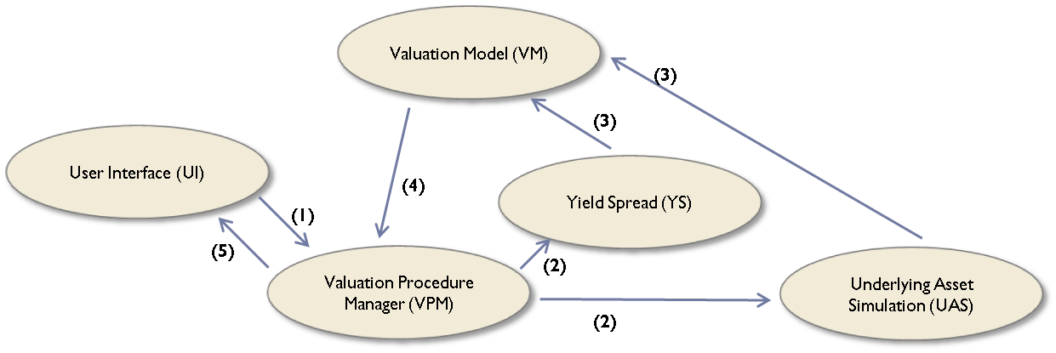
Schematic diagram of valuation service
Notes:
Here is the schematic diagram of our valuation service. It consists of five major modules. They are the User Interface, Valuation Procedure Manager, Valuation Model, Underlying Asset Simulation and Yield Spread.
Valuation Procedure Manager (VPM) is the control flow engine. It reads parameters from User Interface (UI) and returns the valuation result.
Valuation Model (VM) uses backward induction algorithm to calculate the fair value of derivatives by using simulated results of the underlying assets, credit spread and liquidity spread. The derivative provisions, holiday setting and day count convention are also considered by VM when it calculates the fair value.
Underlying Asset Simulation (UAS) simulates the stochastic processes of underlying assets and interest rates and refers to the setting of VM to decide the type of simulation, that is, paths for Monte-Carlo methods and trees for CRR binomial tree.
Yield spread (YS) calculates the credit and liquidity spreads of a derivative. Please find in the paper for more details.

Slide 63
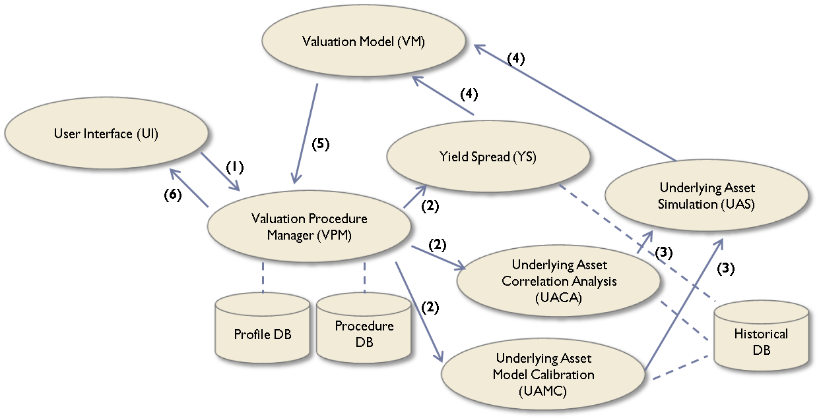
More Details
Notes:
This figure shows the detail schematic diagram of valuation service.
VPM reads the derivative profile from UI or Profile DB, and selects the corresponding procedure from Procedure DM according to the value of derivative type. A valuation procedure determines whether a specific module is invoked or not, for example, Underlying Asset Correlation Analysis (UACA) is invoked when a derivative has multiple underlying assets, such as dual range accrual note.
UACA models correlated risk as a correlation matrix of the underlying assets by using the historical data. Underlying Asset Model Calibration (UAMC) calibrates the parameters of stochastic processes or interest rate models by using the historical data. UAS reads the results from UACA and UAMC modules and simulates the paths or trees of underlying assets.

Slide 64
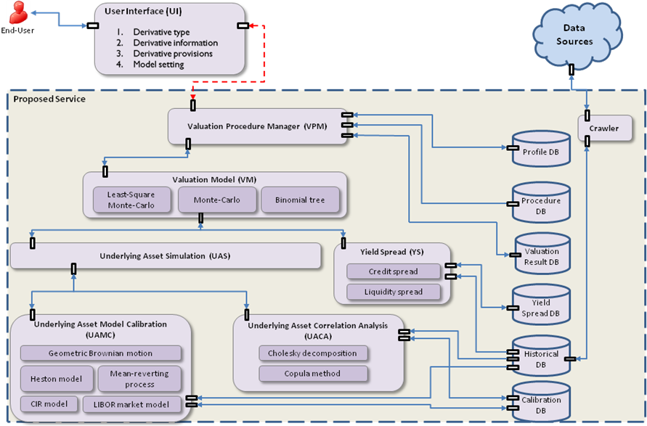
System Architecture

Slide 65
Term sheets of convertible bond
European Convertible Bond (ECB)
Valuation date | 2011/3/25
Issue date | 2010/8/10
Maturity date | 2015/8/10
Credit rating | 2 (TCRI in Taiwan)
Country | Taiwan
Currency | USD
Issuing FX rate | 31.8300
Issuing conversion price | 110.76
Issue price | 100
Maturity price | 102.171
Underlying asset | The common stock of ACER Inc.
Call provision | The issuer can repurchase ECB if the holder’s stock price is higher than the conversion price on 20 consecutive business days after 2013/8/10.
Put provision | The holder can sell its ECB to the issuer at the put price of 101.297 on 2013/8/10
Conversion provision | The holder can convert its ECB to common stock at the conversion price between 2010/9/20 and 2015/9/31.
Asset Swap
Delivery date | 2011/3/25
Maturity date | 2013/8/10
Contract | Receive $100 and pay an American CB call option on the delivery date Receive USD 3M LIBOR + 115bps (30/360) quarterly. Pay $101.297 to counterparty on the maturity date.

Slide 66
Experiments on valuation of convertible bonds
Benchmark
  Market prices as benchmark
  Fair value is not market price
Parameter setting
  Underlying asset simulation
    Stock price and exchange rates
      Geometric Brownian motion
    Risk-free interest rates
      CIR interest rate model
    Volatility calculation
      Historical volatility
    Simulating 2000,000 paths for each underlying asset
  Valuation model
    Least-Square Monte-Carlo method with antithetic variables

Slide 67
Experiments on valuation of convertible bond
European convertible bond (ECB) and asset swap (CBAS)
ECB market price: 104.9287 / 104.1787
Valuation date | 2011/3/25
Fair value of ECB | 104.378671
Standard error | 0.036345
Fair value of CBAS | 0.004817
Fair value of CB option in CBAS | 6.799198
Fair value of synthetic straight bond in CBAS | 97.579473

Slide 68
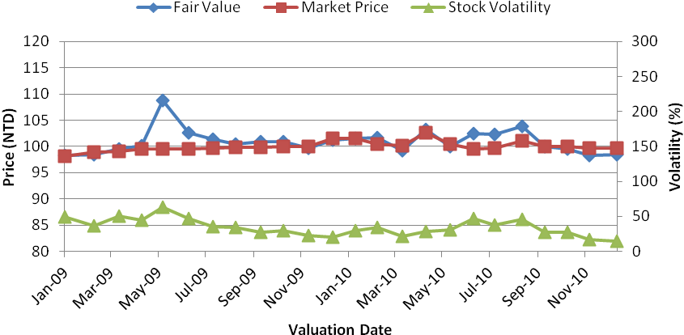
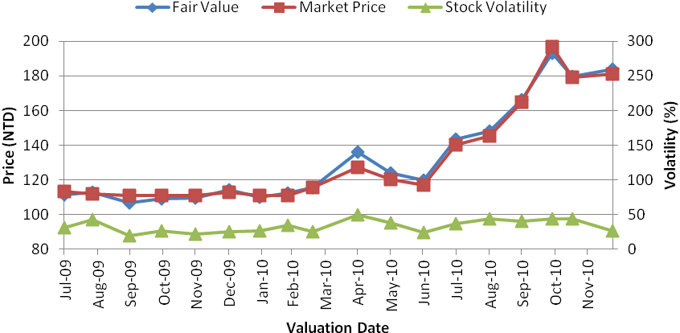
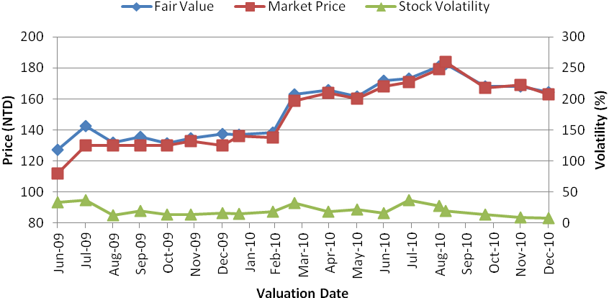
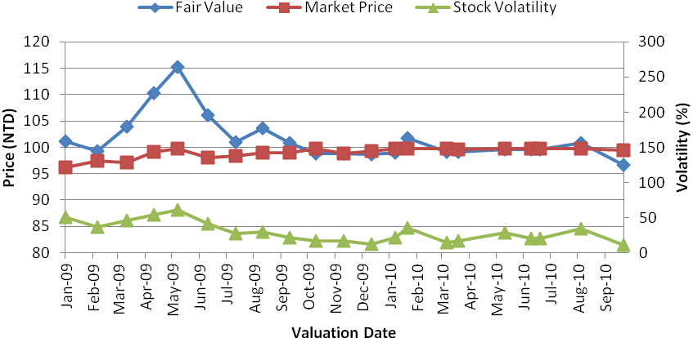
Real-time derivative valuation service
- Illustration of valuation results
CB ID: 23171 (TCRI rating: 4)
CB ID: 19023 (TCRI rating: 5)
CB ID: 14773 (TCRI rating: 3)
CB ID: 140201 (TCRI rating: 4)

Slide 69
Real-time derivative valuation service
- Experiment of convertible bond valuation
46 convertible bonds (CBs) in Taiwan market
  Monthly valuation from 2006 to 2010
Evaluation metrics
  Normalized RMSE
    m_{i} is the market price on day i
    v_{i} is the fair value on day i
  Maximum of Relative Absolute Error
    m_{i} is the market price of the i-th day
    v_{i} is the fair value of the i-th day

Slide 70
Real-time derivative valuation service
- Experiment of convertible bond valuation
CB ID | NRMSE | Max. of Relative Absolute Error | Fair Value |  | Market Price |  | Number of Observations | TCRI Rating
 |  |  | Mean | Variance | Mean | Variance
12101 | 0.138 | 0.370 | 115.198 | 68.248 | 103.926 | 67.882 | 40 | 4
12161 | 0.093 | 0.225 | 105.716 | 33.195 | 98.818 | 7.505 | 37 | 3
12251 | 0.055 | 0.114 | 117.511 | 49.358 | 114.196 | 9.002 | 13 | 7
13121 | 0.093 | 0.246 | 117.709 | 346.118 | 110.227 | 333.042 | 31 | 4
140201 | 0.107 | 0.200 | 107.274 | 79.305 | 99.562 | 16.486 | 37 | 4
14093 | 0.106 | 0.279 | 118.812 | 276.655 | 108.979 | 328.398 | 45 | 5
14371 | 0.078 | 0.105 | 247.213 | 1707.347 | 233.800 | 1222.200 | 5 | 6
14772 | 0.025 | 0.061 | 223.617 | 1585.860 | 221.571 | 1609.648 | 14 | 3
14773 | 0.036 | 0.136 | 153.428 | 354.294 | 149.976 | 451.527 | 19 | 3
15221 | 0.058 | 0.139 | 111.222 | 122.354 | 107.597 | 110.457 | 30 | 5
15242 | 0.126 | 0.154 | 98.512 | 6.172 | 112.500 | 1.000 | 4 | 7
15281 | 0.092 | 0.184 | 103.171 | 290.304 | 101.296 | 114.455 | 25 | 6
15291 | 0.077 | 0.126 | 144.889 | 1416.439 | 137.543 | 1293.046 | 7 | 6
15323 | 0.045 | 0.104 | 287.122 | 786.220 | 288.000 | 583.000 | 7 | 7
15371 | 0.063 | 0.162 | 134.457 | 1300.202 | 129.312 | 1549.028 | 33 | 5

Slide 71
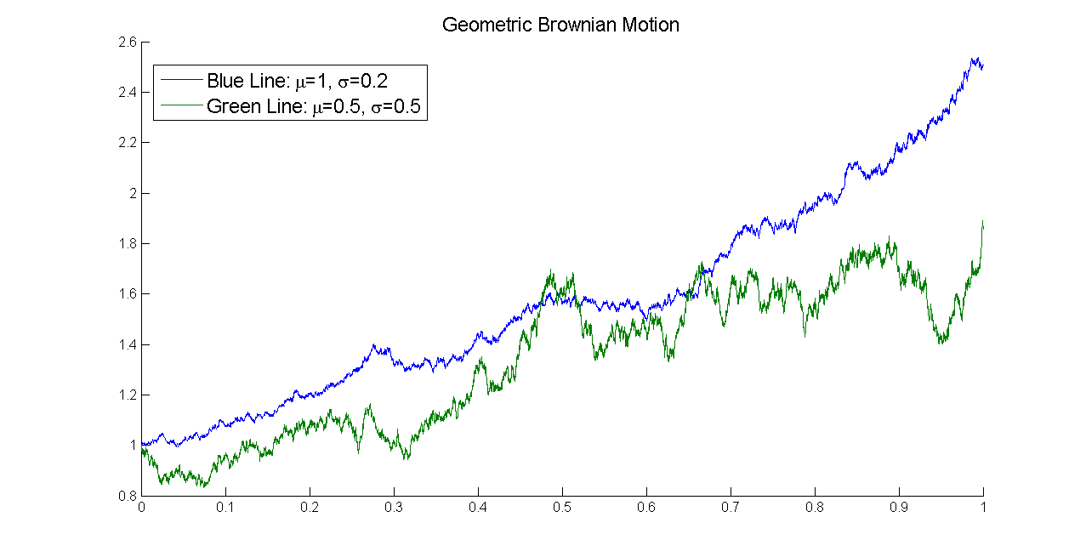
Stock Model: Geometric Brownian motion (GBM)
      S_{t}: Stock price at time t
      W_{t}: Wiener process or Brownian motion
      μ: Drift term is constant
      σ: Volatility of stock prices is constant
Source: Wikipedia

Slide 72
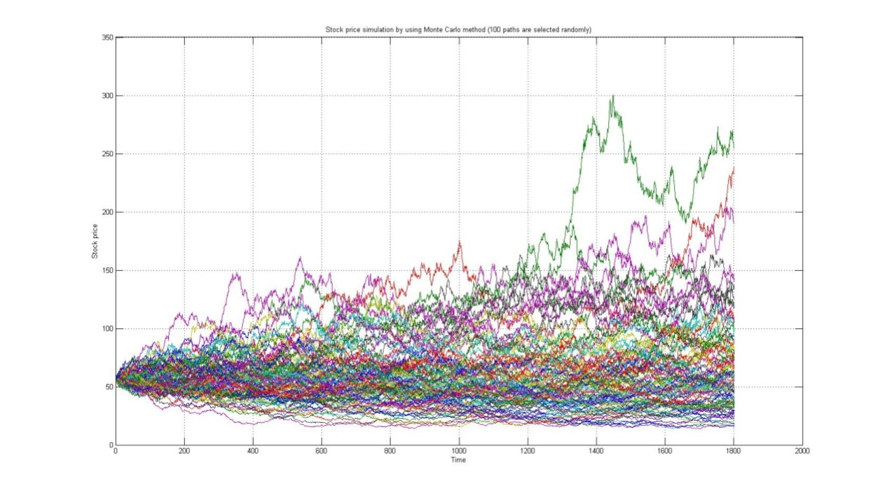
Modified least-square Monte-Carlo model
Stock Price Simulation by geometric Brownian motion
(100 paths are selected randomly)
Properties of geometric Brownian motion
  Period from pricing date is longer, variations of reference entities is larger
Keeping less information near the pricing date, and sampling more paths when near the maturity date

Slide 73
Credit risk
Estimating default intensity (hazard rate) using Duffie’s model

Slide 74
Interest rate Model
CIR interest rate model (follows mean-reverting process)
  Ensuring mean reversion of the interest rate towards the long run value b, with speed of adjustment governed by the strictly positive parameter a
  σ is a volatility of interest rate, and Wt is a Wiener process
LIBOR market model
  L_{j} is the forward rate for the period [T_{j}, T_{j+1}], and σ_{j} is a volatility of forward rate for the period [T_{j}, T_{j+1}]
  W^{QTj} is a Wiener process under T_{j}-forward measure Q_{Tj}

Slide 75
Market risk
Equity risk
  Using historical volatility calculation to model stock prices
    R_{i} is the rate of return at time i, and n is the calculation period
Interest rate risk
  Simulating interest rates by using interest rate model with observable data in the market
    CIR interest rate model (follows mean-reverting process)
      Ensuring mean reversion of the interest rate towards the long run value b, with speed of adjustment governed by the strictly positive parameter a
      σ is a volatility of interest rate, and Wt is a Wiener process
    LIBOR market model
      L_{j} is the forward rate for the period [T_{j}, T_{j+1}], and σ_{j} is a volatility of forward rate for the period [T_{j}, T_{j+1}]
      W^{QTj} is a Wiener process under T_{j}-forward measure Q_{Tj}

Slide 76
Liquidity risk - 1
Definition
  The gap between fundamental value and actually transacted value
Traditional estimation approach
  Information cost model
    Trading volume
    Bid-ask spreads
  Problem
    Measurement is unavailable when the derivative is illiquid

Slide 77
Liquidity risk -2
Latent liquidity
  Measuring liquidity of a derivative without using transaction data
  It measures the accessibility of a security from sources where the security is currently being held
    L^{i}_{t} is latent liquidity for bond I at time t
    π^{i}_{j,t} is the fractional holding of fund j at the end of month t
    T_{j,t} is the turnover of fund j from month t to month t-12
Estimating latent liquidity of a security by using its property
  Credit quality, age, issue size, and optionalities such as call, put or convertibility

Slide 78
Liquidity Risk - 3
Value_{j,t} is the value of fund j at the end of month t
Vol_{j,t} is the dollar trading volume of fund j from month t to month t-12

Slide 79
Valuation of Mortgages
Real-time Derivative Valuation Service
Notes:
I’ll present our strategies of taking the opportunity in this presentation. I’ll skip the last sections in case of running out of time. For these skipped sections, please look into the slides if you are interested.

Slide 80
Mortgage and Its Derivatives
RMBS and CDO
Valuation of Mortgage?

Slide 81
Pricing Mortgage Loan
Fixed-Rate Mortgages (FRMs)
Default Risk
  Borrower unwilling or unable to pay their debt
  Auction off security to redeem partial amount of money
Prepayment Risk
  Refinancing
  Receive full amount of the outstanding
  Lose all interest after the prepayment date

Slide 82
Fixed-Rate Mortgages (FRMs)
Fully amortizing
  Constant interest rate
  Constant payment
Value of the FRM to the bank?
The Ideal Cash Flow
Constant payment
Constant payment
Constant payment
Constant payment
Constant payment
Lending date
Payment date 1
Payment date 2
Payment date n-1
Maturity date
principal
Notes:
Fully amortization implies that major portion of he initial constant payments pays the interest instead of the principle.

Slide 83
Default
Borrower unwilling or unable to pay their debt
  Partial amount of money
    Auction security
Partial amount of money
Constant payment
Constant payment
Constant payment
Lending date
Payment date 1
Payment date 2
Default date
Payment date n-1
Maturity date
principal

Slide 84
Prepayment
Debt is repaid in advanced
  Fully prepayment
    Refinancing
    Receive all of the outstanding
    Lose all interest after the prepayment date
Outstanding
Constant payment
Constant payment
Constant payment
Lending date
Payment date 1
Payment date 2
Prepayment date
Payment date n-1
Maturity date
principal

Slide 85
Weaknesses of the Previous Approach
Prepayment loss rate
Determined
Using Tsai el al(2009)
model
Not a constant!!
Notes:
請一誠修改這一頁！

Slide 86
Current Progress
Modeling and derivation of exact solution of valuating mortgages
Opera Solutions
Notes:
Based on the finding, we present a new model and thus the derivation of exact solution of valuating mortgages.
Also to mention is the potential industrial collaboration requested by the Opera Solutions during our participation in the conference CIFER 2012.

Slide 87
Modeling Mortgage Loan
Default and prepayment risk
  Poisson processes with time-varying intensities
  Interest rate as the only state variable
  Intensities as linear functions of interest rate

Slide 88
  A FRM with fixed payment Y and coupon rate c, initial outstanding M₀, and maturity T
  The payment Y
  The outstanding principal at time t
Discrete approximation
  Risk-neutral pricing model
  where V_{i} is the mortgage price at time i, i=0,1,2,…,n=T/Δt. PV(.) and E_{i}(.) denotes the present value and expectation of the information at time i under risk-neutral measure.
Pricing Framework
Notes:
Note M(t)=M(t-1)(1+ r) -Y

Slide 89
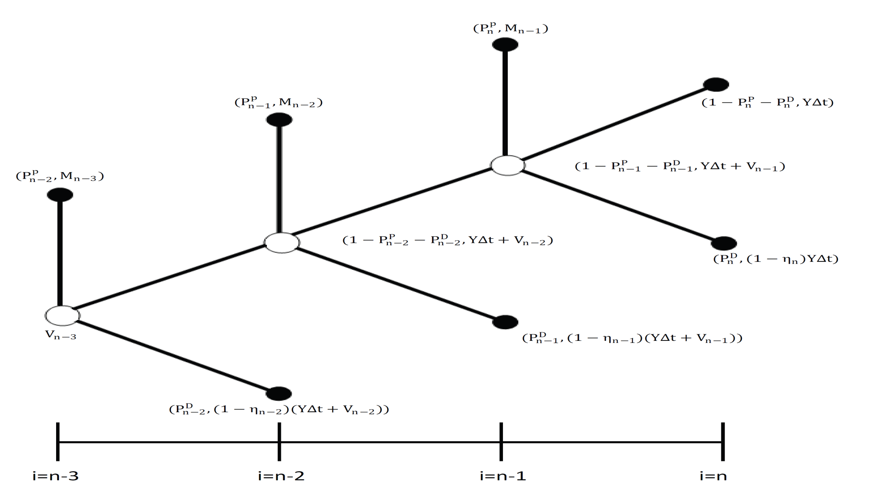
Backward Induction
Notes:
After defining these notations, we use backward induction to obtain V zero. This figure shows the possible behaviors of a borrower from time n minus 3 to n
For FRMs, Vn is zero. V n minus 1(Vn-1) equals the expectation of the discount of these possible cash flows. This path denotes the event of prepayment; this is normal payment, and this is the default event. The same, we obtain V n minus 2(Vn-2). And so on.

Slide 90
Discrete Model with Risk Consideration
Denote and as default and prepayment probabilities, respectively
  with initial probability
  with initial probability
where and denote the time occurrence of default and prepayment respectively
Discrete time model

Slide 91
Expression of Initial Mortgage Value
Discrete time form
  Backward Induction
Continuous time form
  Default and prepayment risk follow Poisson process with time-varying intensities
First expectation
Second expectation

Slide 92
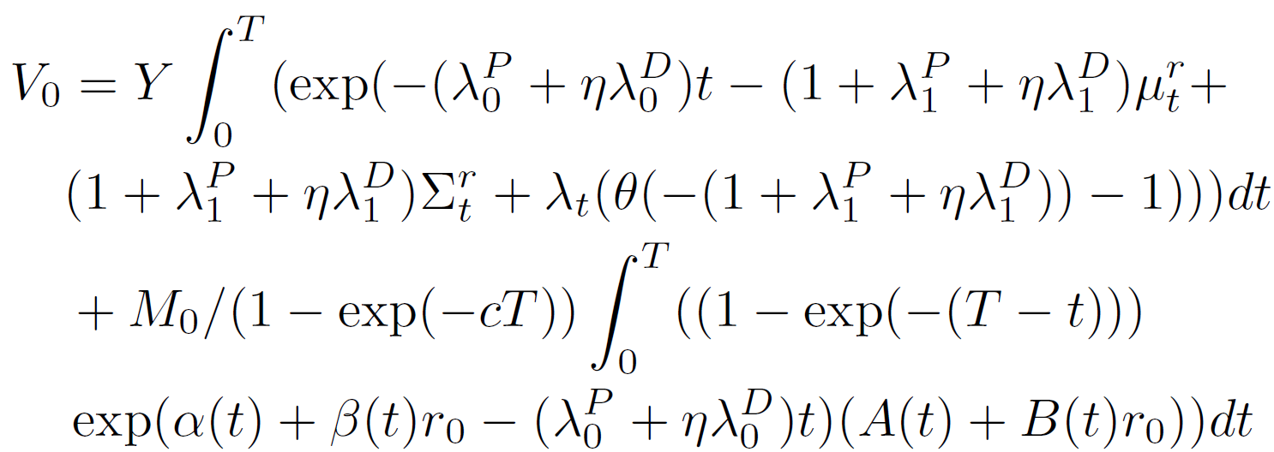
Closed-Form Formula

Slide 93
Benchmarking Trading Algorithms
Notes:
I’ll present our strategies of taking the opportunity in this presentation. I’ll skip the last sections in case of running out of time. For these skipped sections, please look into the slides if you are interested.

Slide 94
Benchmarking Trading Algorithms
Mutual fund and trading algorithms
Maximum return subject to number of transactions
  the all-in-all-out trading strategy
Notes:
We present efficient algorithms for the MRT problem and also prove their correctness.

Slide 95
Notes:
Bull Market vs Bear Market

Slide 96
Sept. 1 to Aug. 30 of
the next year

Slide 100
Research Team
Prof. William WY Hsu
Dr. Cheng-Yu Lu
Yi-Cheng Tsai
Da-Wei Hung
Hsin-Tsung Peng

Slide 101
Collaborators
Chung-Su Wu, President of CIER
Ming-Yang Kao, Department of EECS, Northwestern University
Yuh-Dau Lu, Department of CSIE, NTU
Szu-Lang Liao, Department of Money and Banking, NCCU
Tai-Chang Wang, Department of Accounting, NTU
Ruey S. Tsay, University of Chicago
Jin-Chuan Duan, Director of Risk Management Institute, NUS

